Slide 1
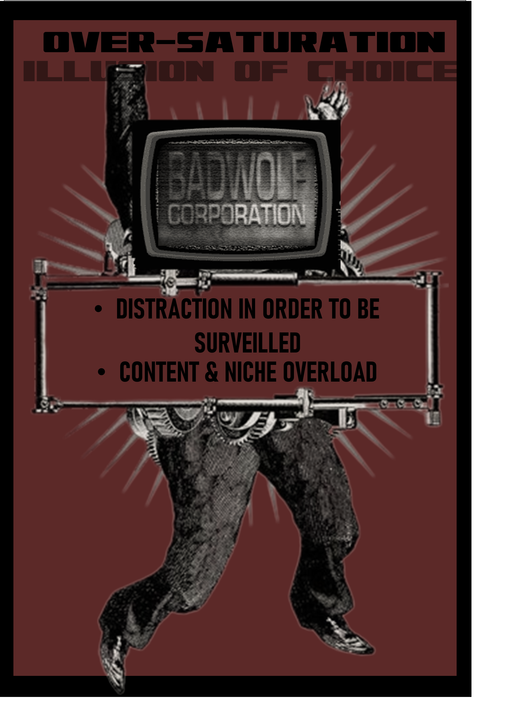
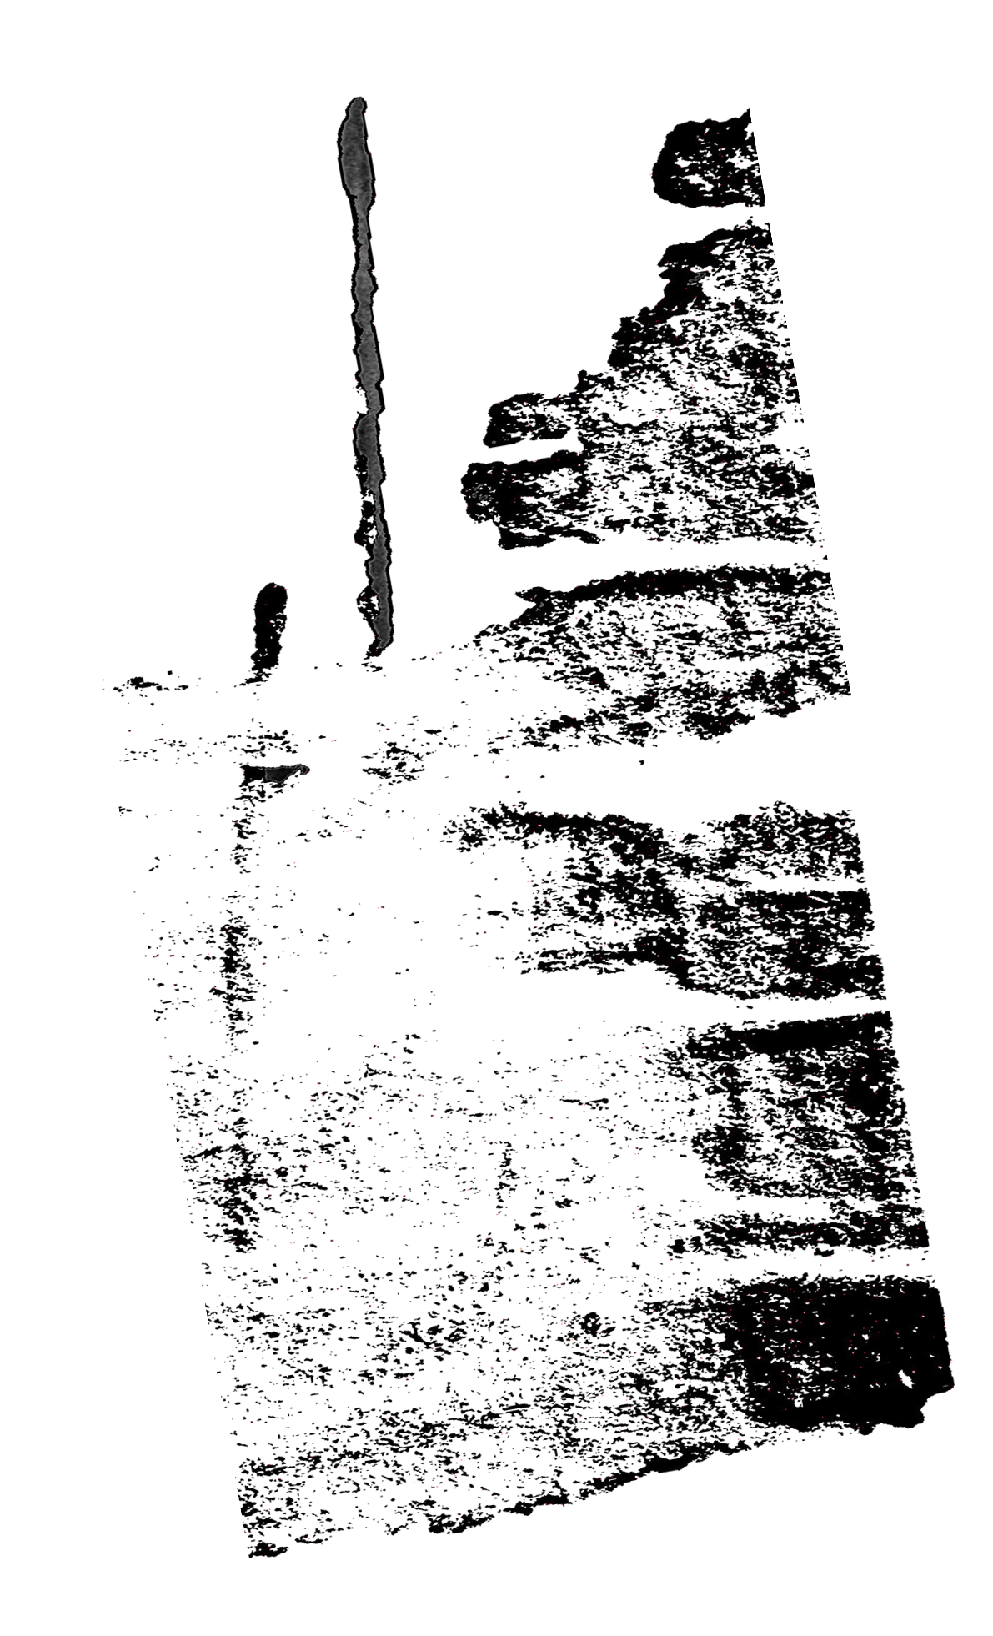
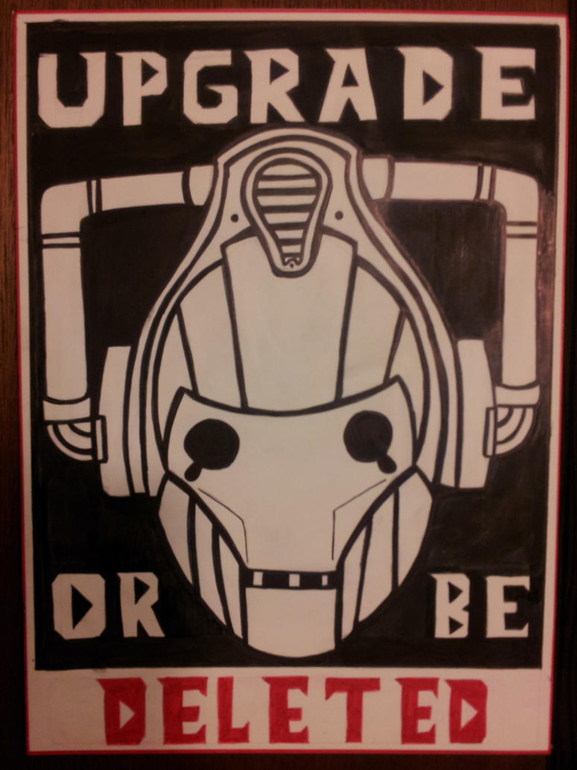
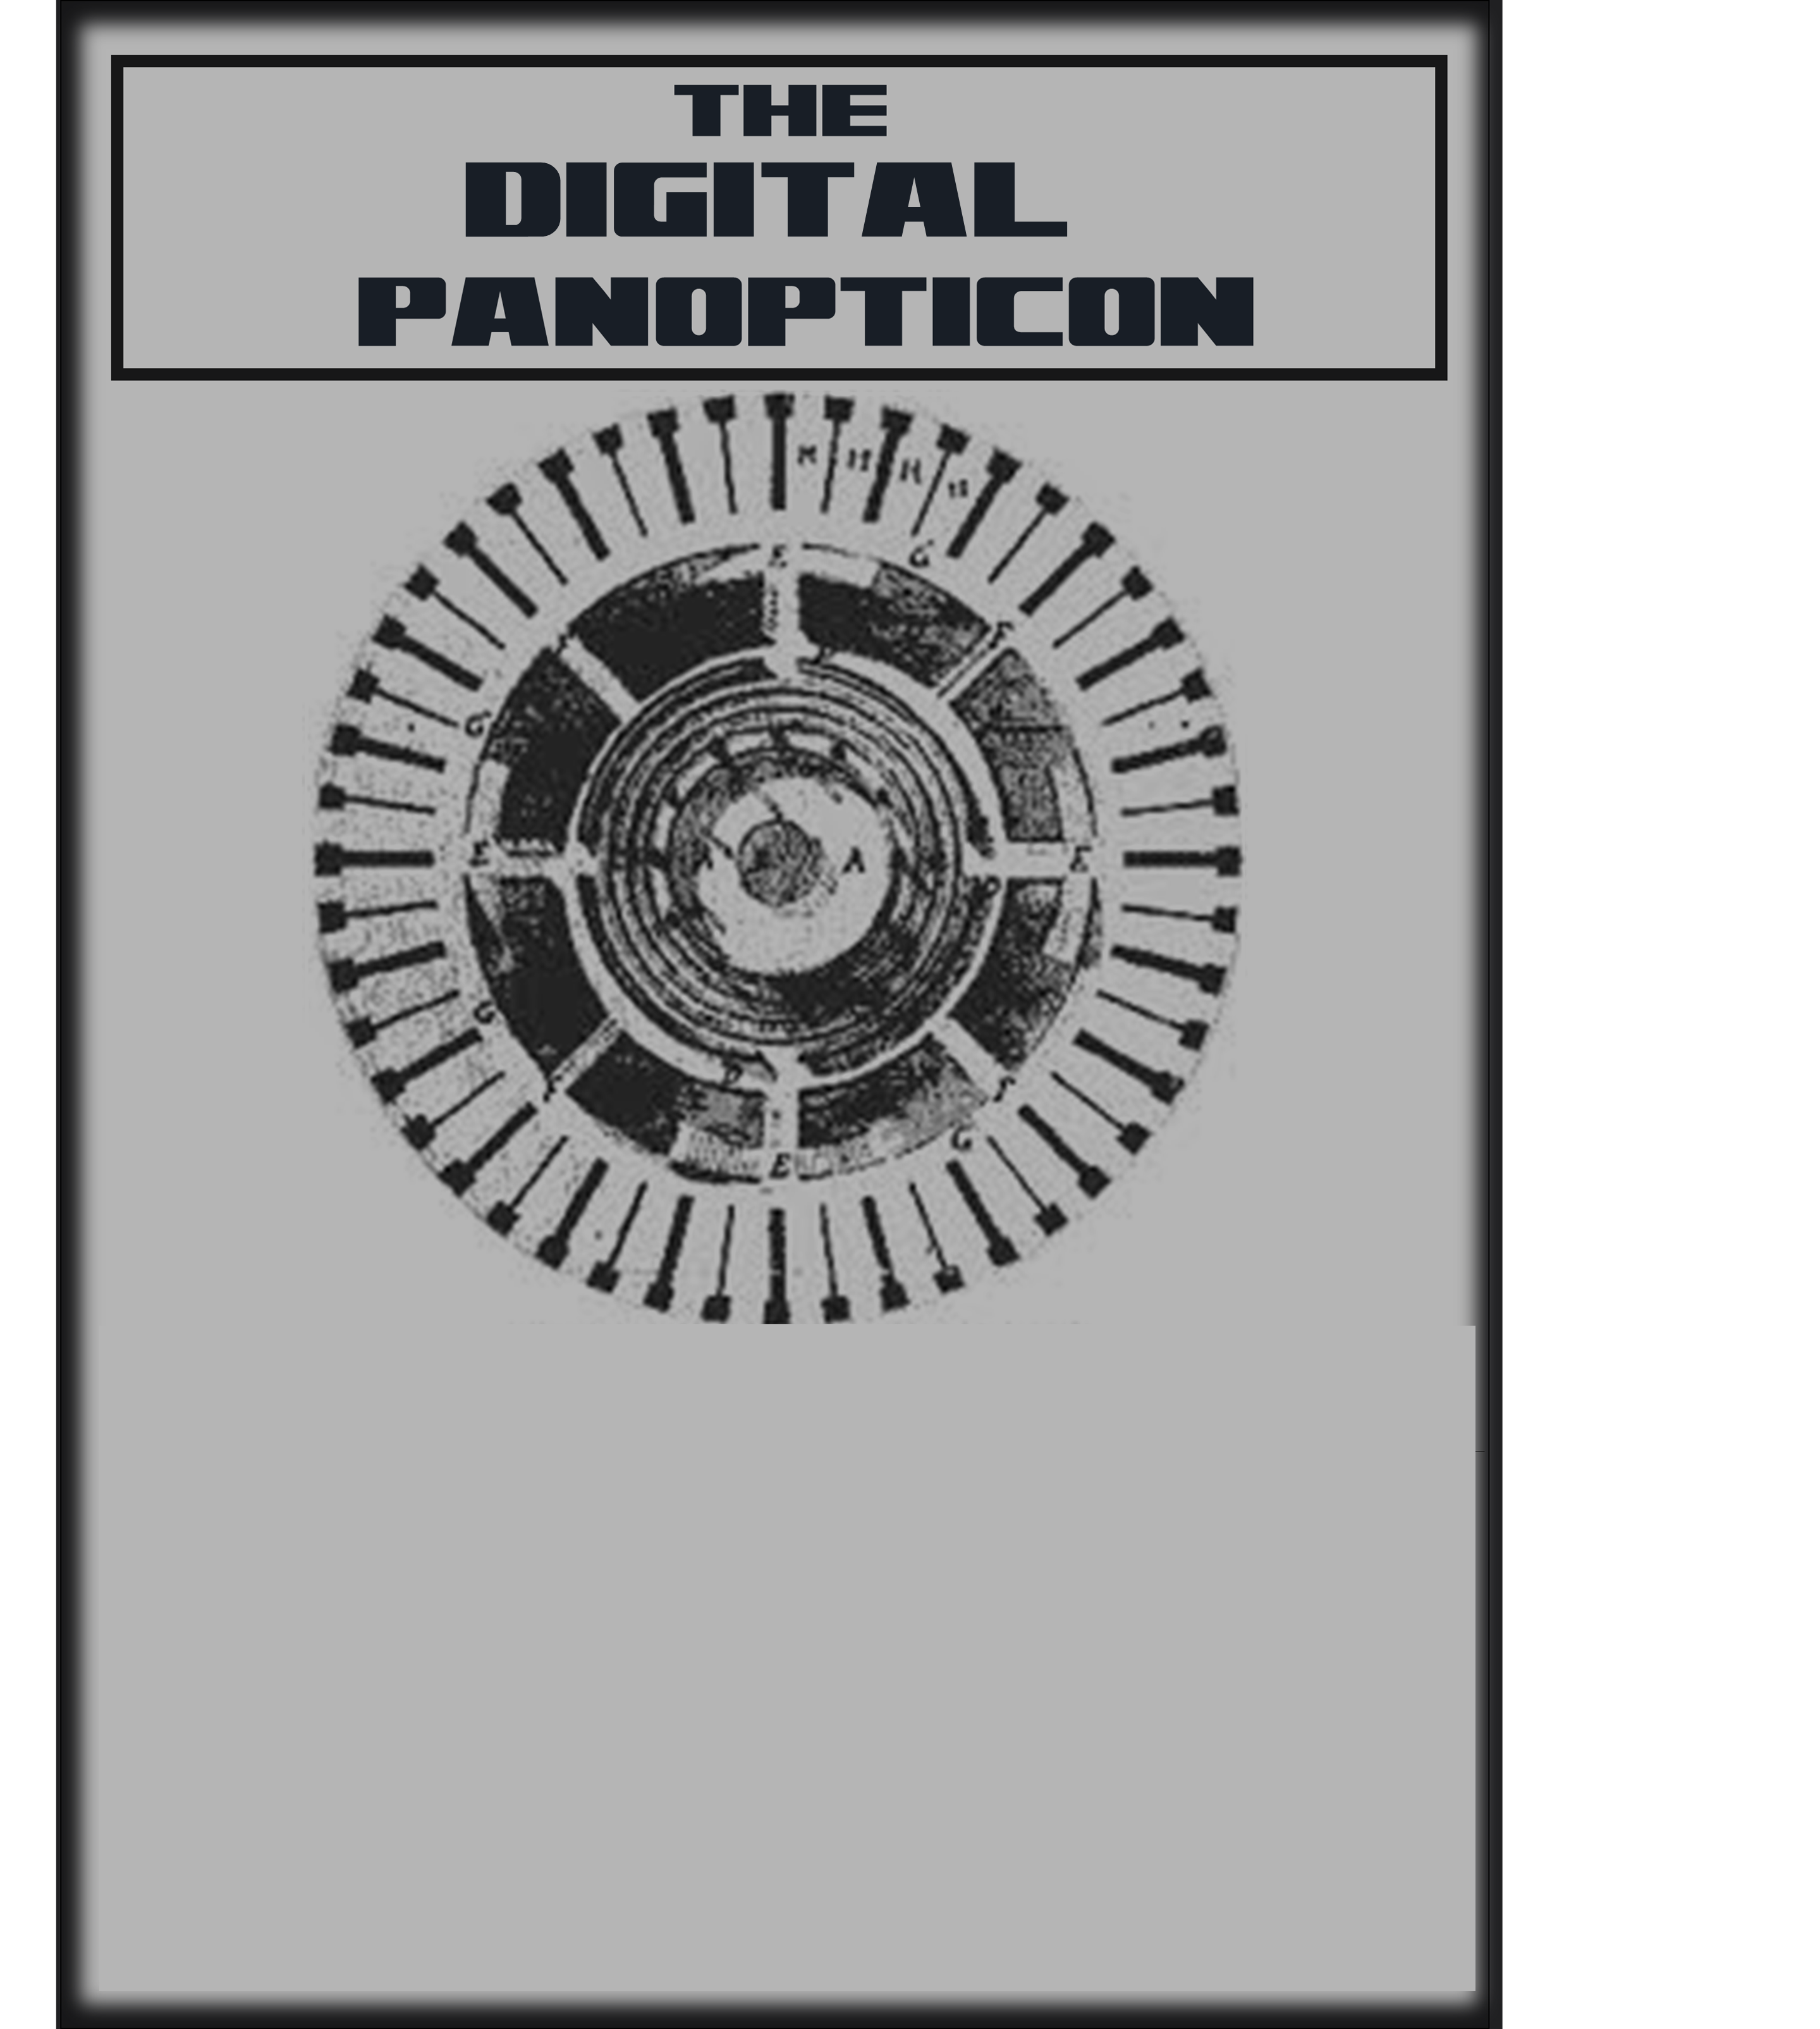
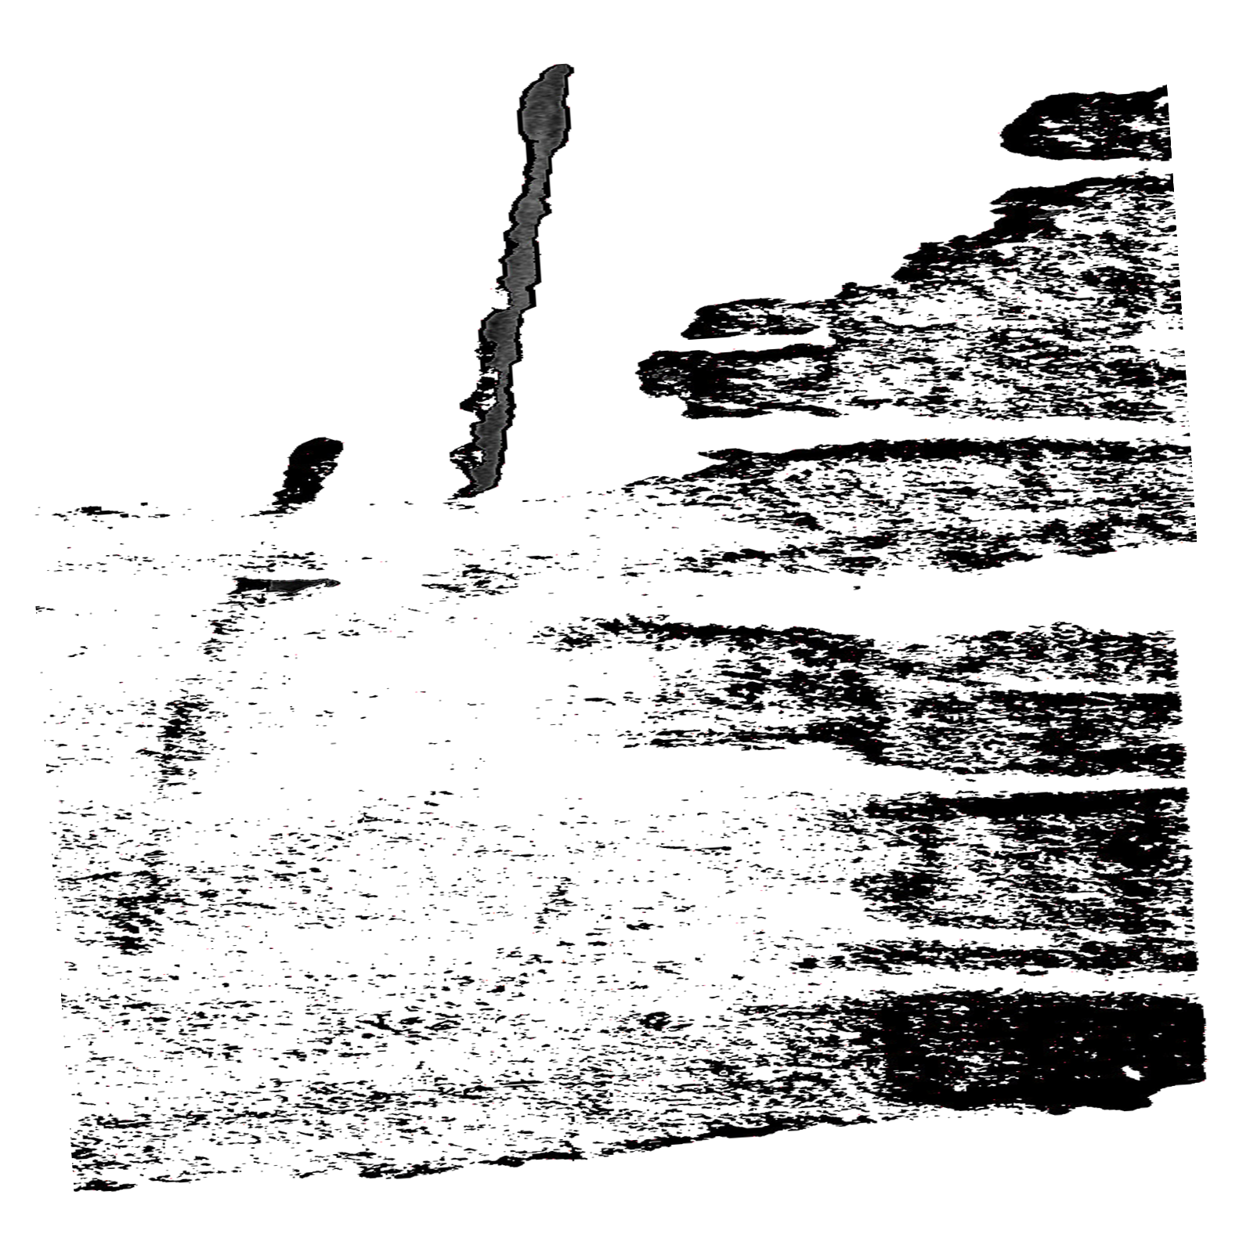
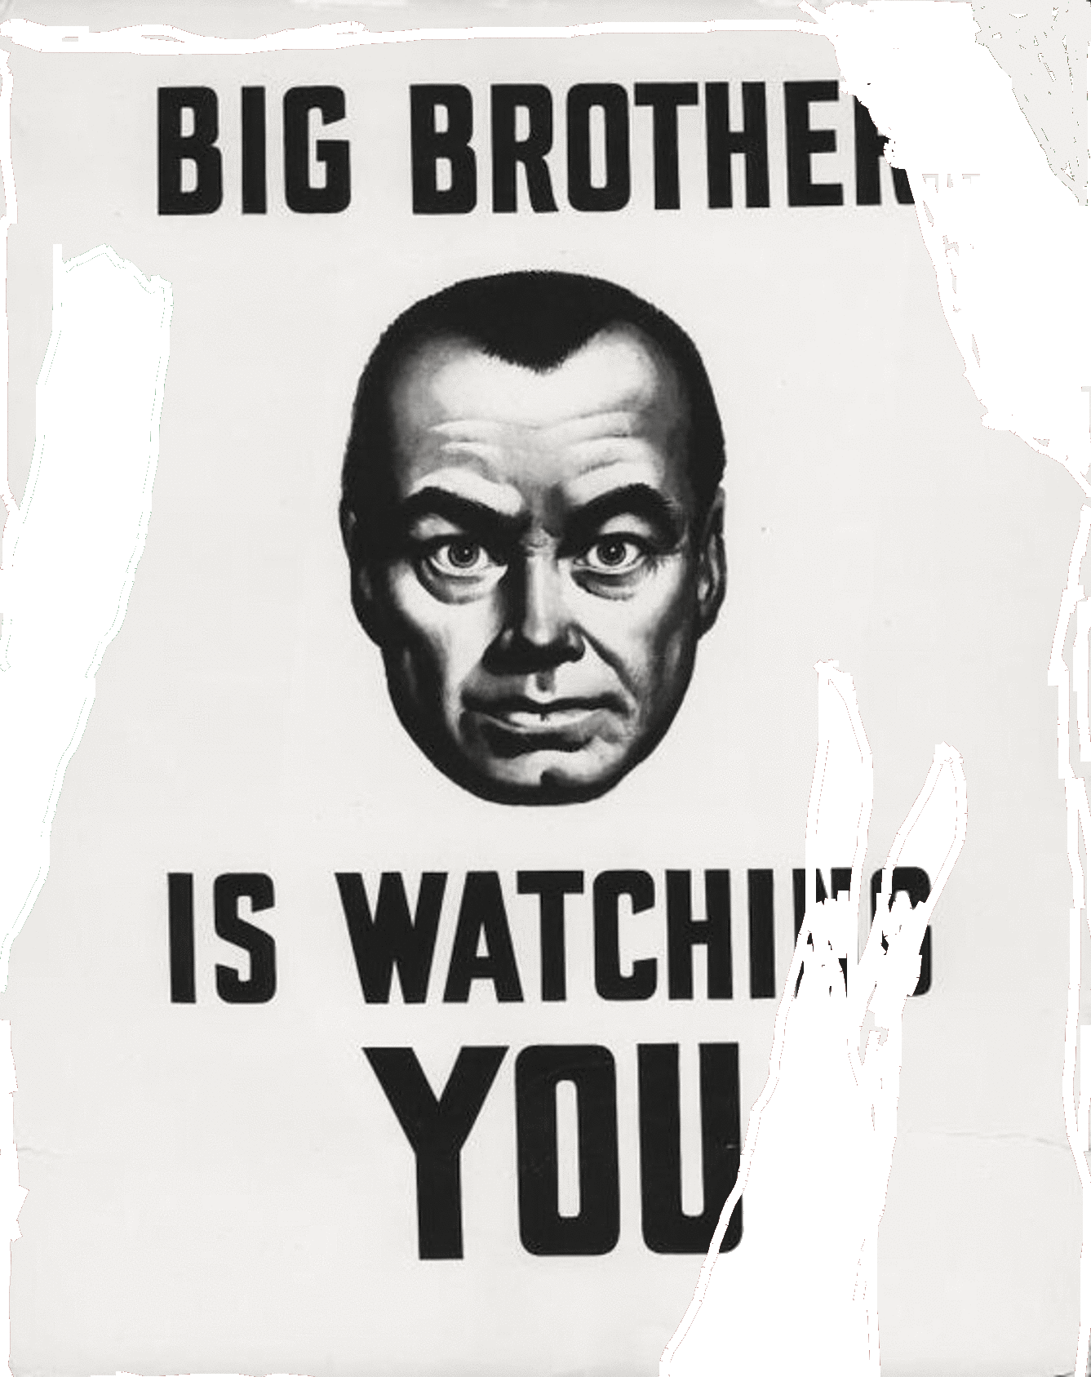
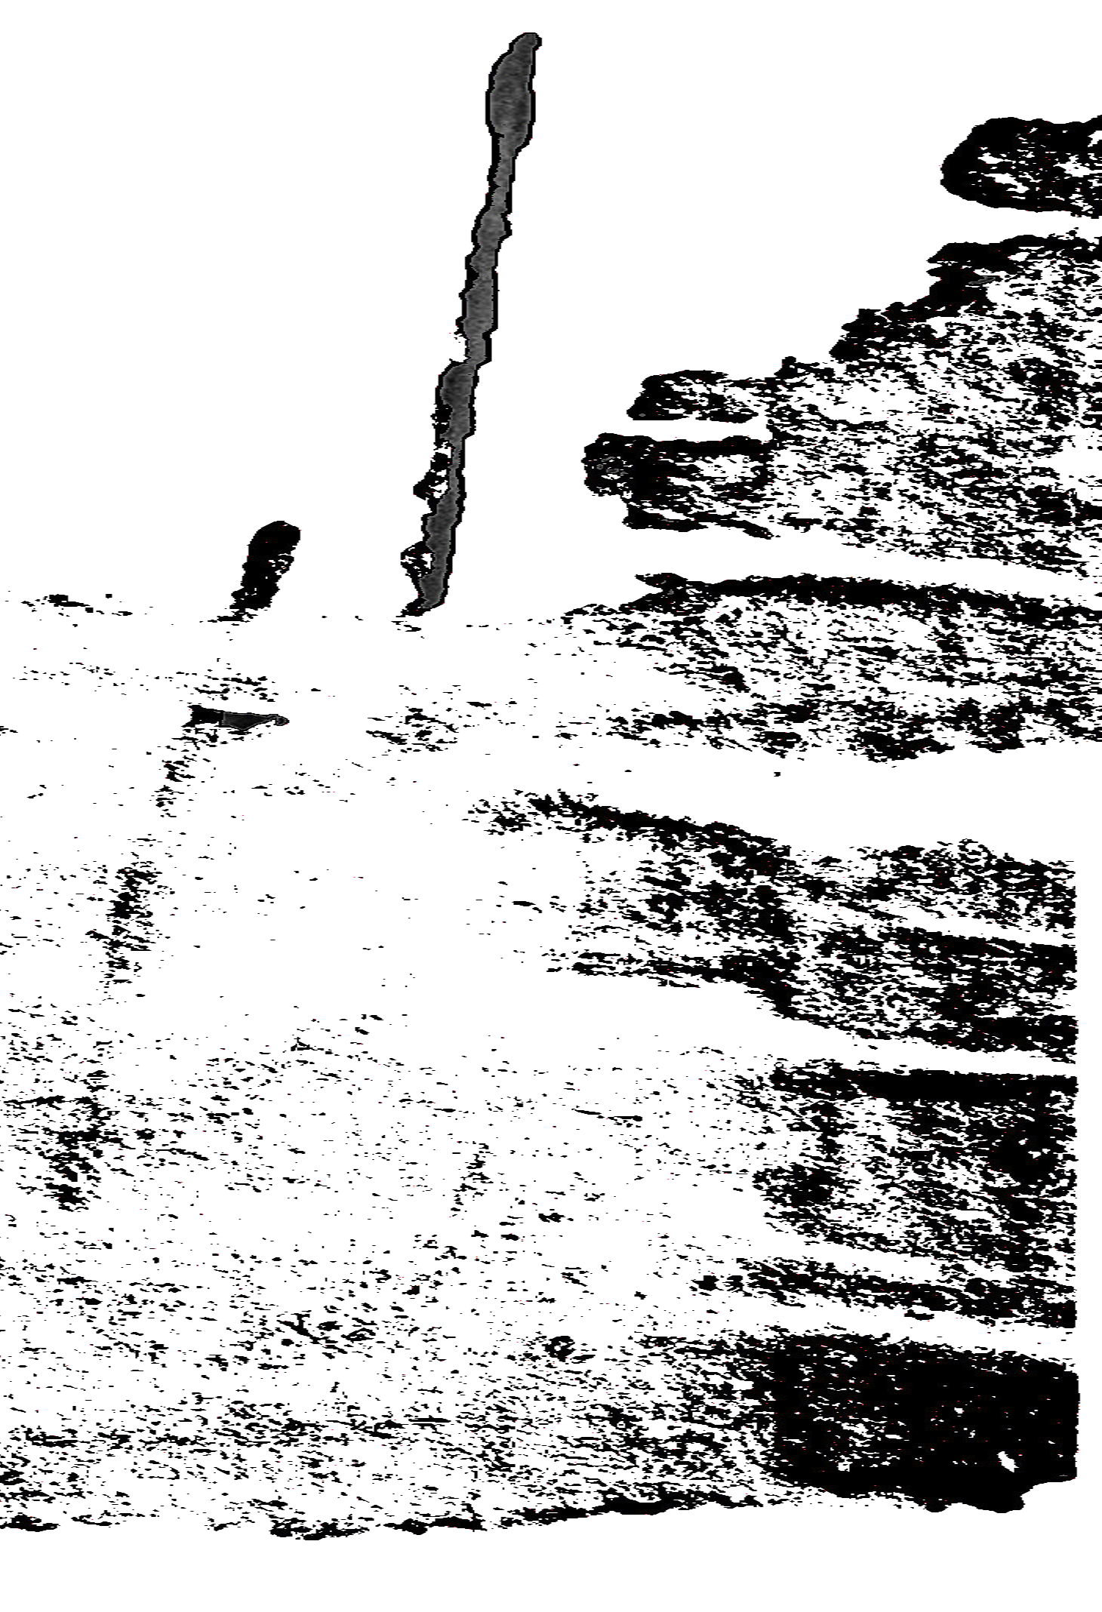
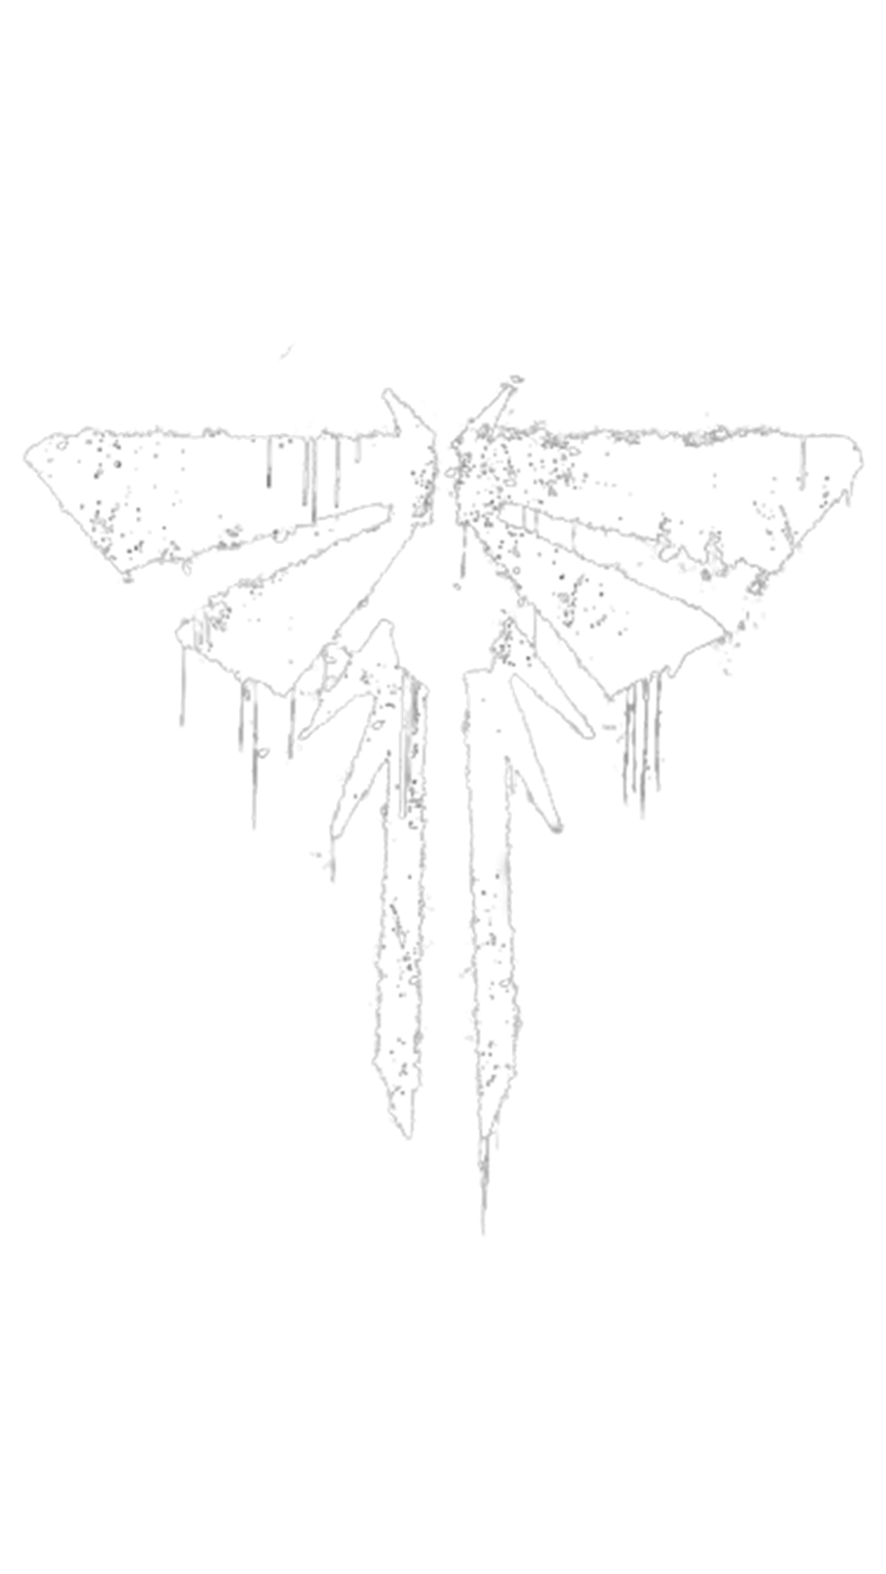
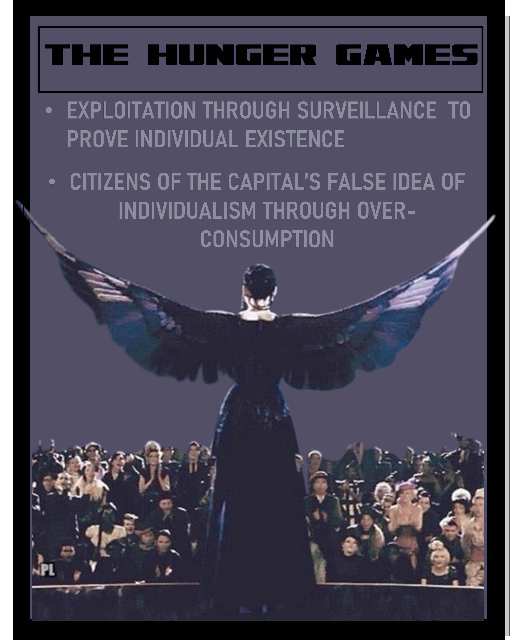
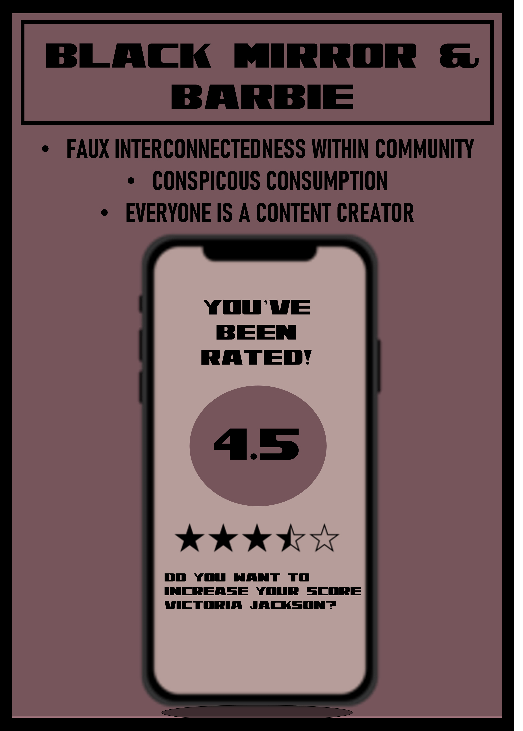
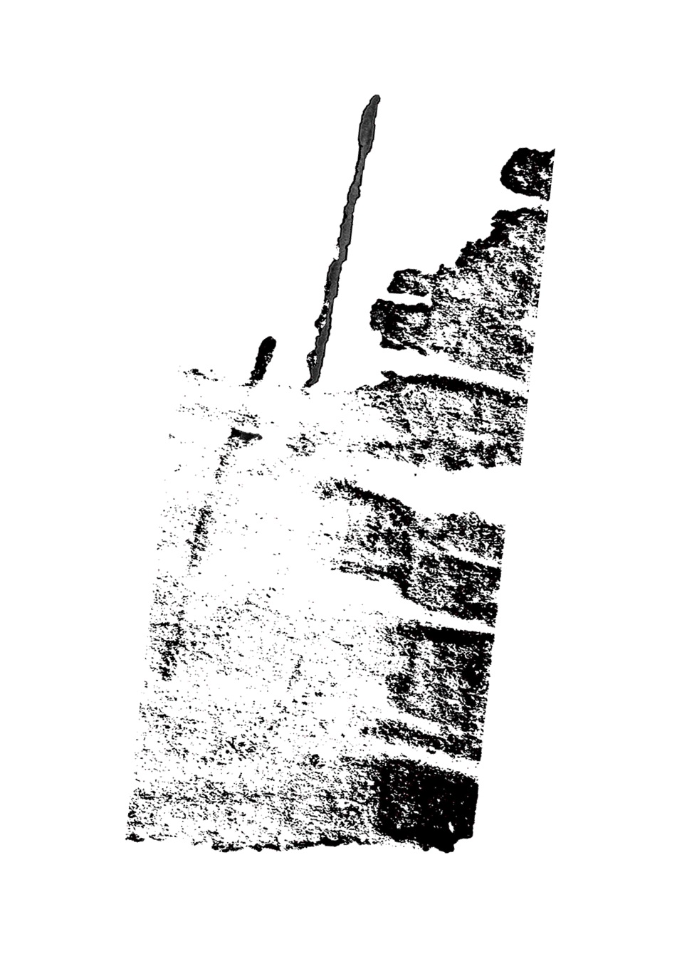
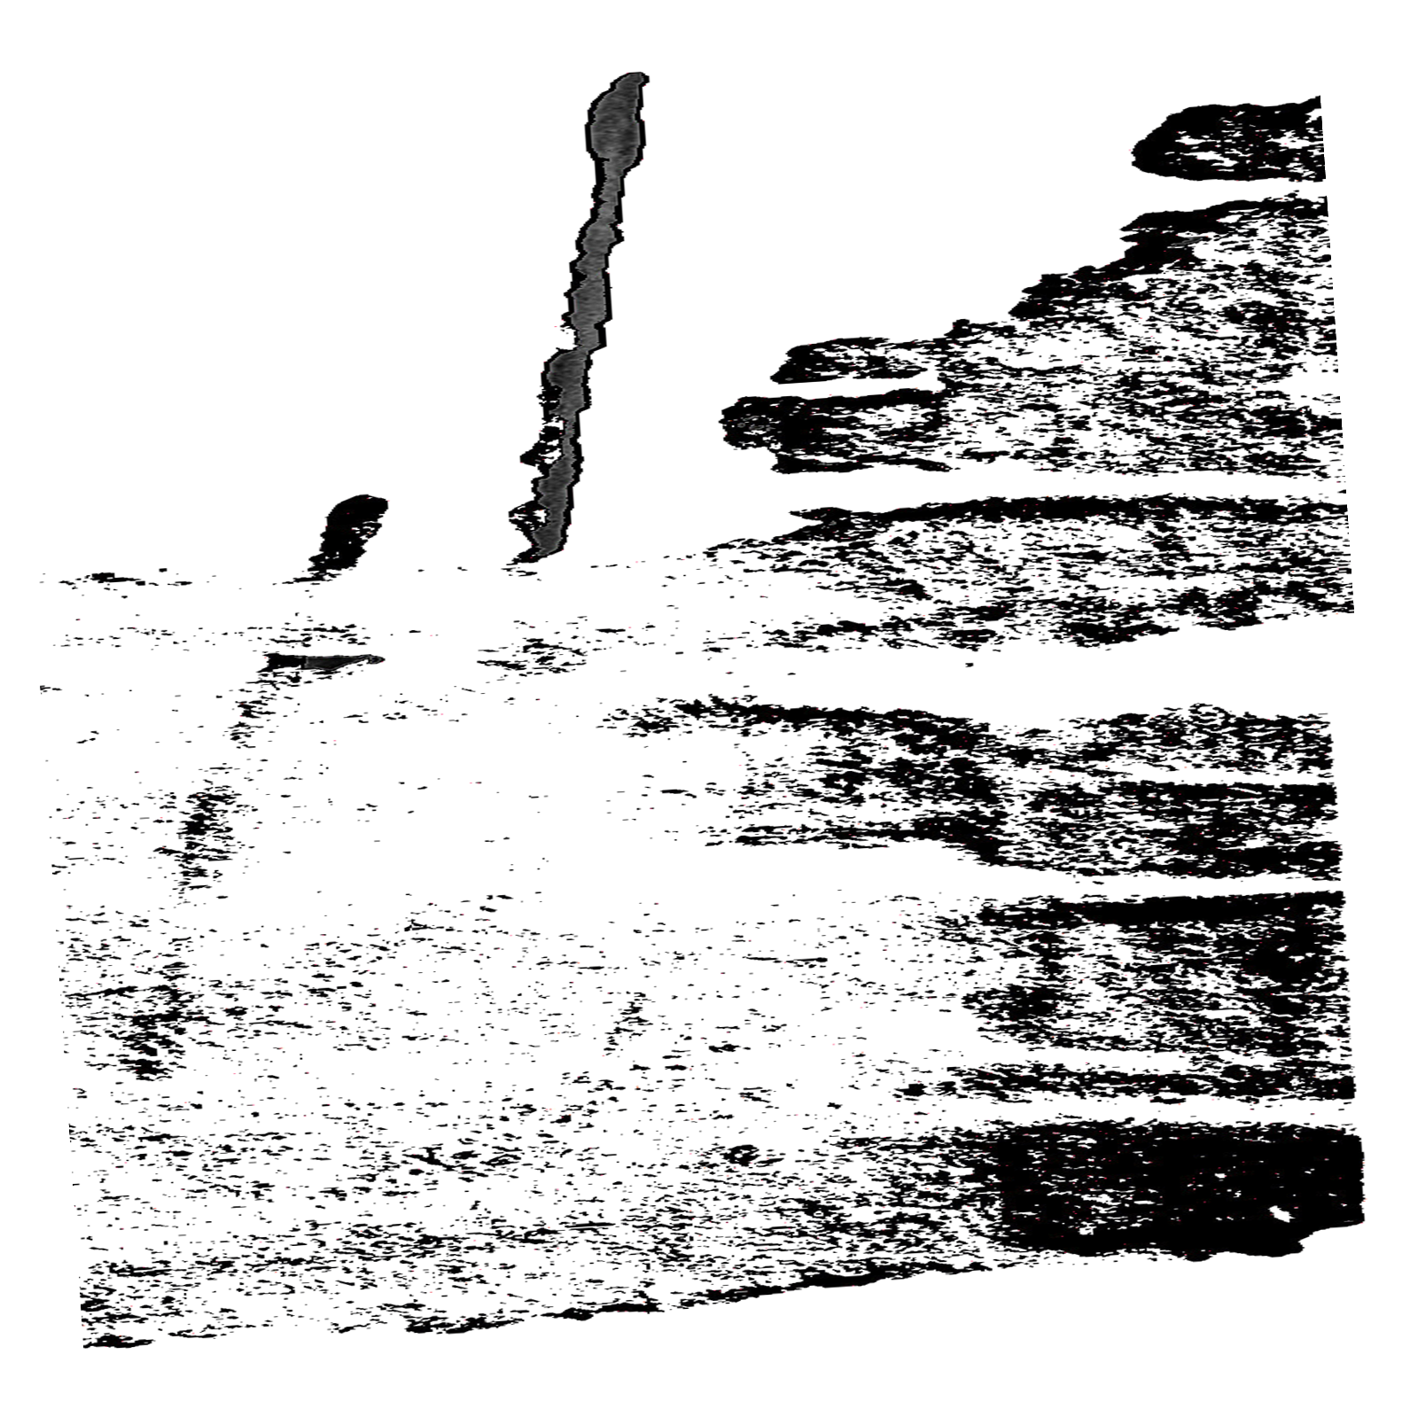
I’M PERCEIVED THEREFORE, I AM:
Dystopian Narratives, Self-Commodifying, and Generation Z's 21st-century Perception of Individuality.

Slide 2
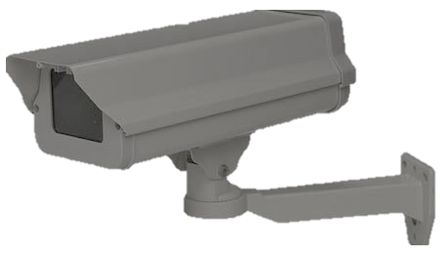
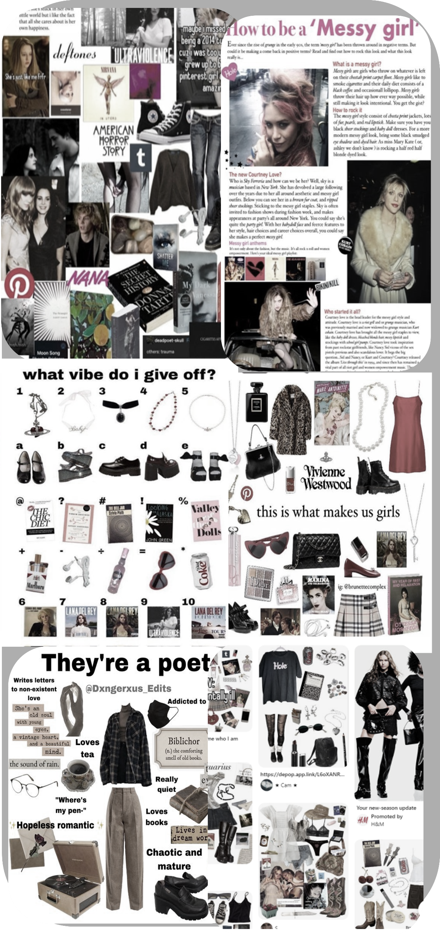
The
Genesis
Who am I ?
Heightened Surveillance
The
Conversation
Coming of age exploration of identity
Becoming a “person” and wanting to be seen
Seeking refuge in online communities
Immersion in subcultures
Realization of commodification of identity
Caricature of the identity
Why?
The
panopticon
A PARADOX
BRAVE
NEW WORLD
Doctor
Who
BLACK
MIRROR
Barbie
hunger games
The
question

Slide 3
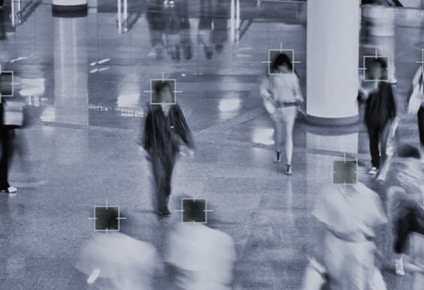
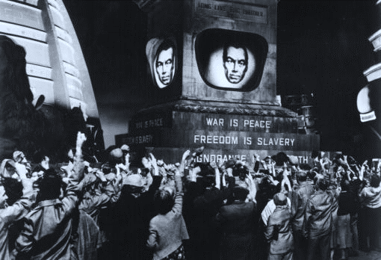
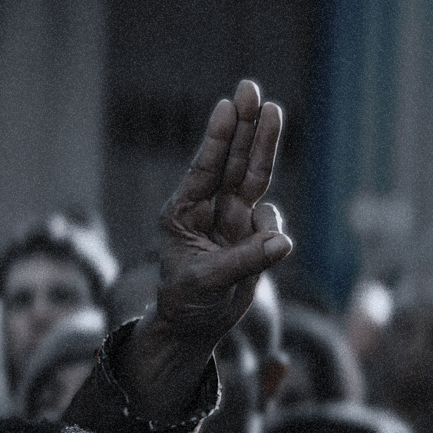
The
Genesis
Now more than ever,
the possibility of being perceived has increased tremendously
97% of people in America have a phone.
93% of Gen Z have/use social media in their everyday
51 million homes have video surveillance systems in the USA.
Approximately 325 million possible sets of eyes on you while logged into the digital world.
Heightened Surveillance
80% of people have location sharing activated on their phones.
The
Conversation
We are in a surveillance state.
The
panopticon
A PARADOX
HEIGHTENED SURVEILLANCE
BRAVE
NEW WORLD
Doctor
Who
Dystopian Narratives:
Display many aspects of how heightened surveillance has a profound effect on the perception of individualism especially among younger generations
There is a unique and profound connection
observed between identity and heightened surveillance
Narratives: Brave New World, Doctor Who, Hunger Games, Black Mirror’s Nosedive, Nope, and Barbie
How long do we need to hear the warnings?
BLACK
MIRROR
Barbie
hunger games
The
question

Slide 4
The
Genesis
The conversation
Heightened Surveillance
The
Conversation
The conversation around surveillance is continuously adapting and evolving in relation to the new media in which surveillance occurs through such as, the ubiquitous use of social media in our contemporary digital world.
The
panopticon
“Surveillance Culture” and 1984
1984: Cornerstone of Conversation
Gen Z seems to be doing the inverse of the 1984 idea of surveillance; they are surveilling themselves
A PARADOX
BRAVE
NEW WORLD
Doctor
Who
BLACK
MIRROR
Barbie
hunger games
The
question

Slide 5
The
Genesis
The conversation
Heightened Surveillance
MODERN SURVILLENCE IS EXPLOTATION OF OURSELVES
The
Conversation
The
panopticon
Self-surveillance
The desire to be seen and perceived
Commodification of human experience into a sellable, consumable package
We know we are constantly being surveilled, so we have succumbed to it.
Is escaping even possible?
A PARADOX
BRAVE
NEW WORLD
Doctor
Who
BLACK
MIRROR
Barbie
hunger games
The
question

Slide 6
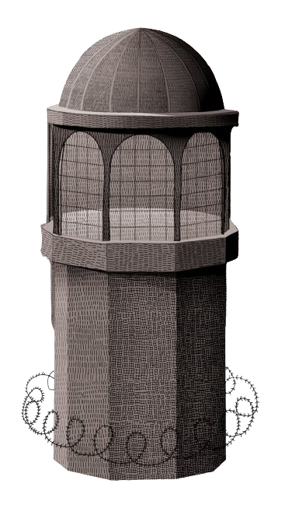
The
Genesis
The
panopticon
Heightened Surveillance
The
Conversation
In the 1700s Jeremy Bentham created the idea of a prison that would have a central observation tower with one watchman encased around prison cells
In the 1970s Michel Foucault brought the panopticon to wider attention, discussing it as a metaphor
Creating the concept of internalized authority and prison of the mind
The
panopticon
The
panopticon
Changing your behavior based on the Belief you are being watched.
A PARADOX
BRAVE
NEW WORLD
Doctor
Who
BLACK
MIRROR
Barbie
hunger games
The
question

Slide 7
The
Genesis
The
panopticon
Heightened Surveillance
We live in an entirely new world than Foucault, Bentham, or Orwell. Our world is digital, thus shifting the panoptic lens.
“Foucault continues to reign supreme in surveillance studies and perhaps its time to cut the head off the king”
The
Conversation
The
panopticon
The
panopticon
A PARADOX
BRAVE
NEW WORLD
Doctor
Who
BLACK
MIRROR
Barbie
hunger games
The
question

Slide 8
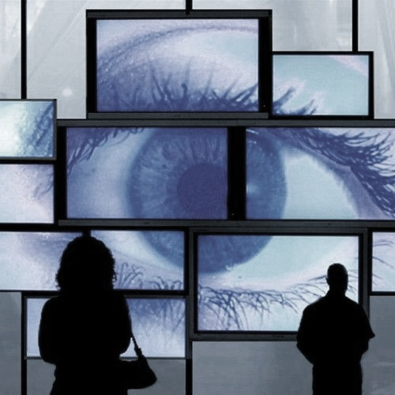
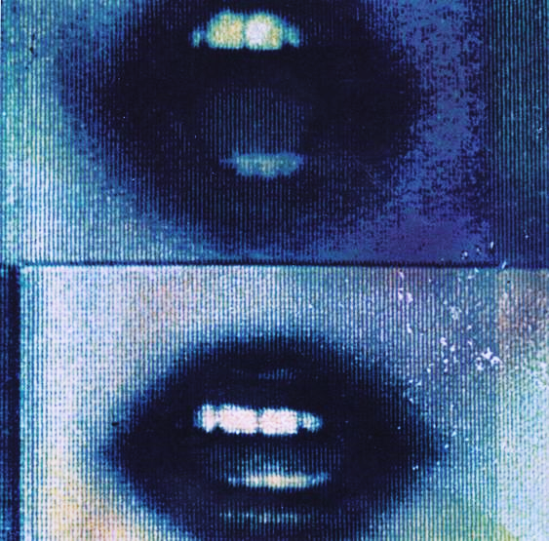
The
Genesis
The
Digital
panopticon
Heightened Surveillance
Fear of the Possibility of scrutiny leads to conformity within communities
The
Conversation
Hyper-Perceptibility:
anyone can be a watchman at all times
The watchman is the idea of someone-
the possibility of someone watching you, viewing your online profile.
The
panopticon
The
panopticon
A PARADOX
BRAVE
NEW WORLD
Heightened possibility of potential perceptibility and the possibility of scrutiny causes Gen Z to commodify and self-mythologize their identity to be easily digestible to consumers
(their peers)
Doctor
Who
BLACK
MIRROR
Barbie
hunger games
The
question

Slide 9
The
Genesis
THE Digital
Identity
Heightened Surveillance
The
Conversation
Online we are reduced to a pixelized version of ourselves- a 2D profile picture across social media platforms
The
panopticon
The
panopticon
A PARADOX
BRAVE
NEW WORLD
Instagram Feed: Looks
Spotify: Music taste
Pinterest: Interest
Twitter: Your words
Doctor
Who
Self-mythologizing: the act of creating or promoting larger-than-life image of oneself
Forced or Natural
BLACK
MIRROR
Barbie
hunger games
The
question

Slide 10
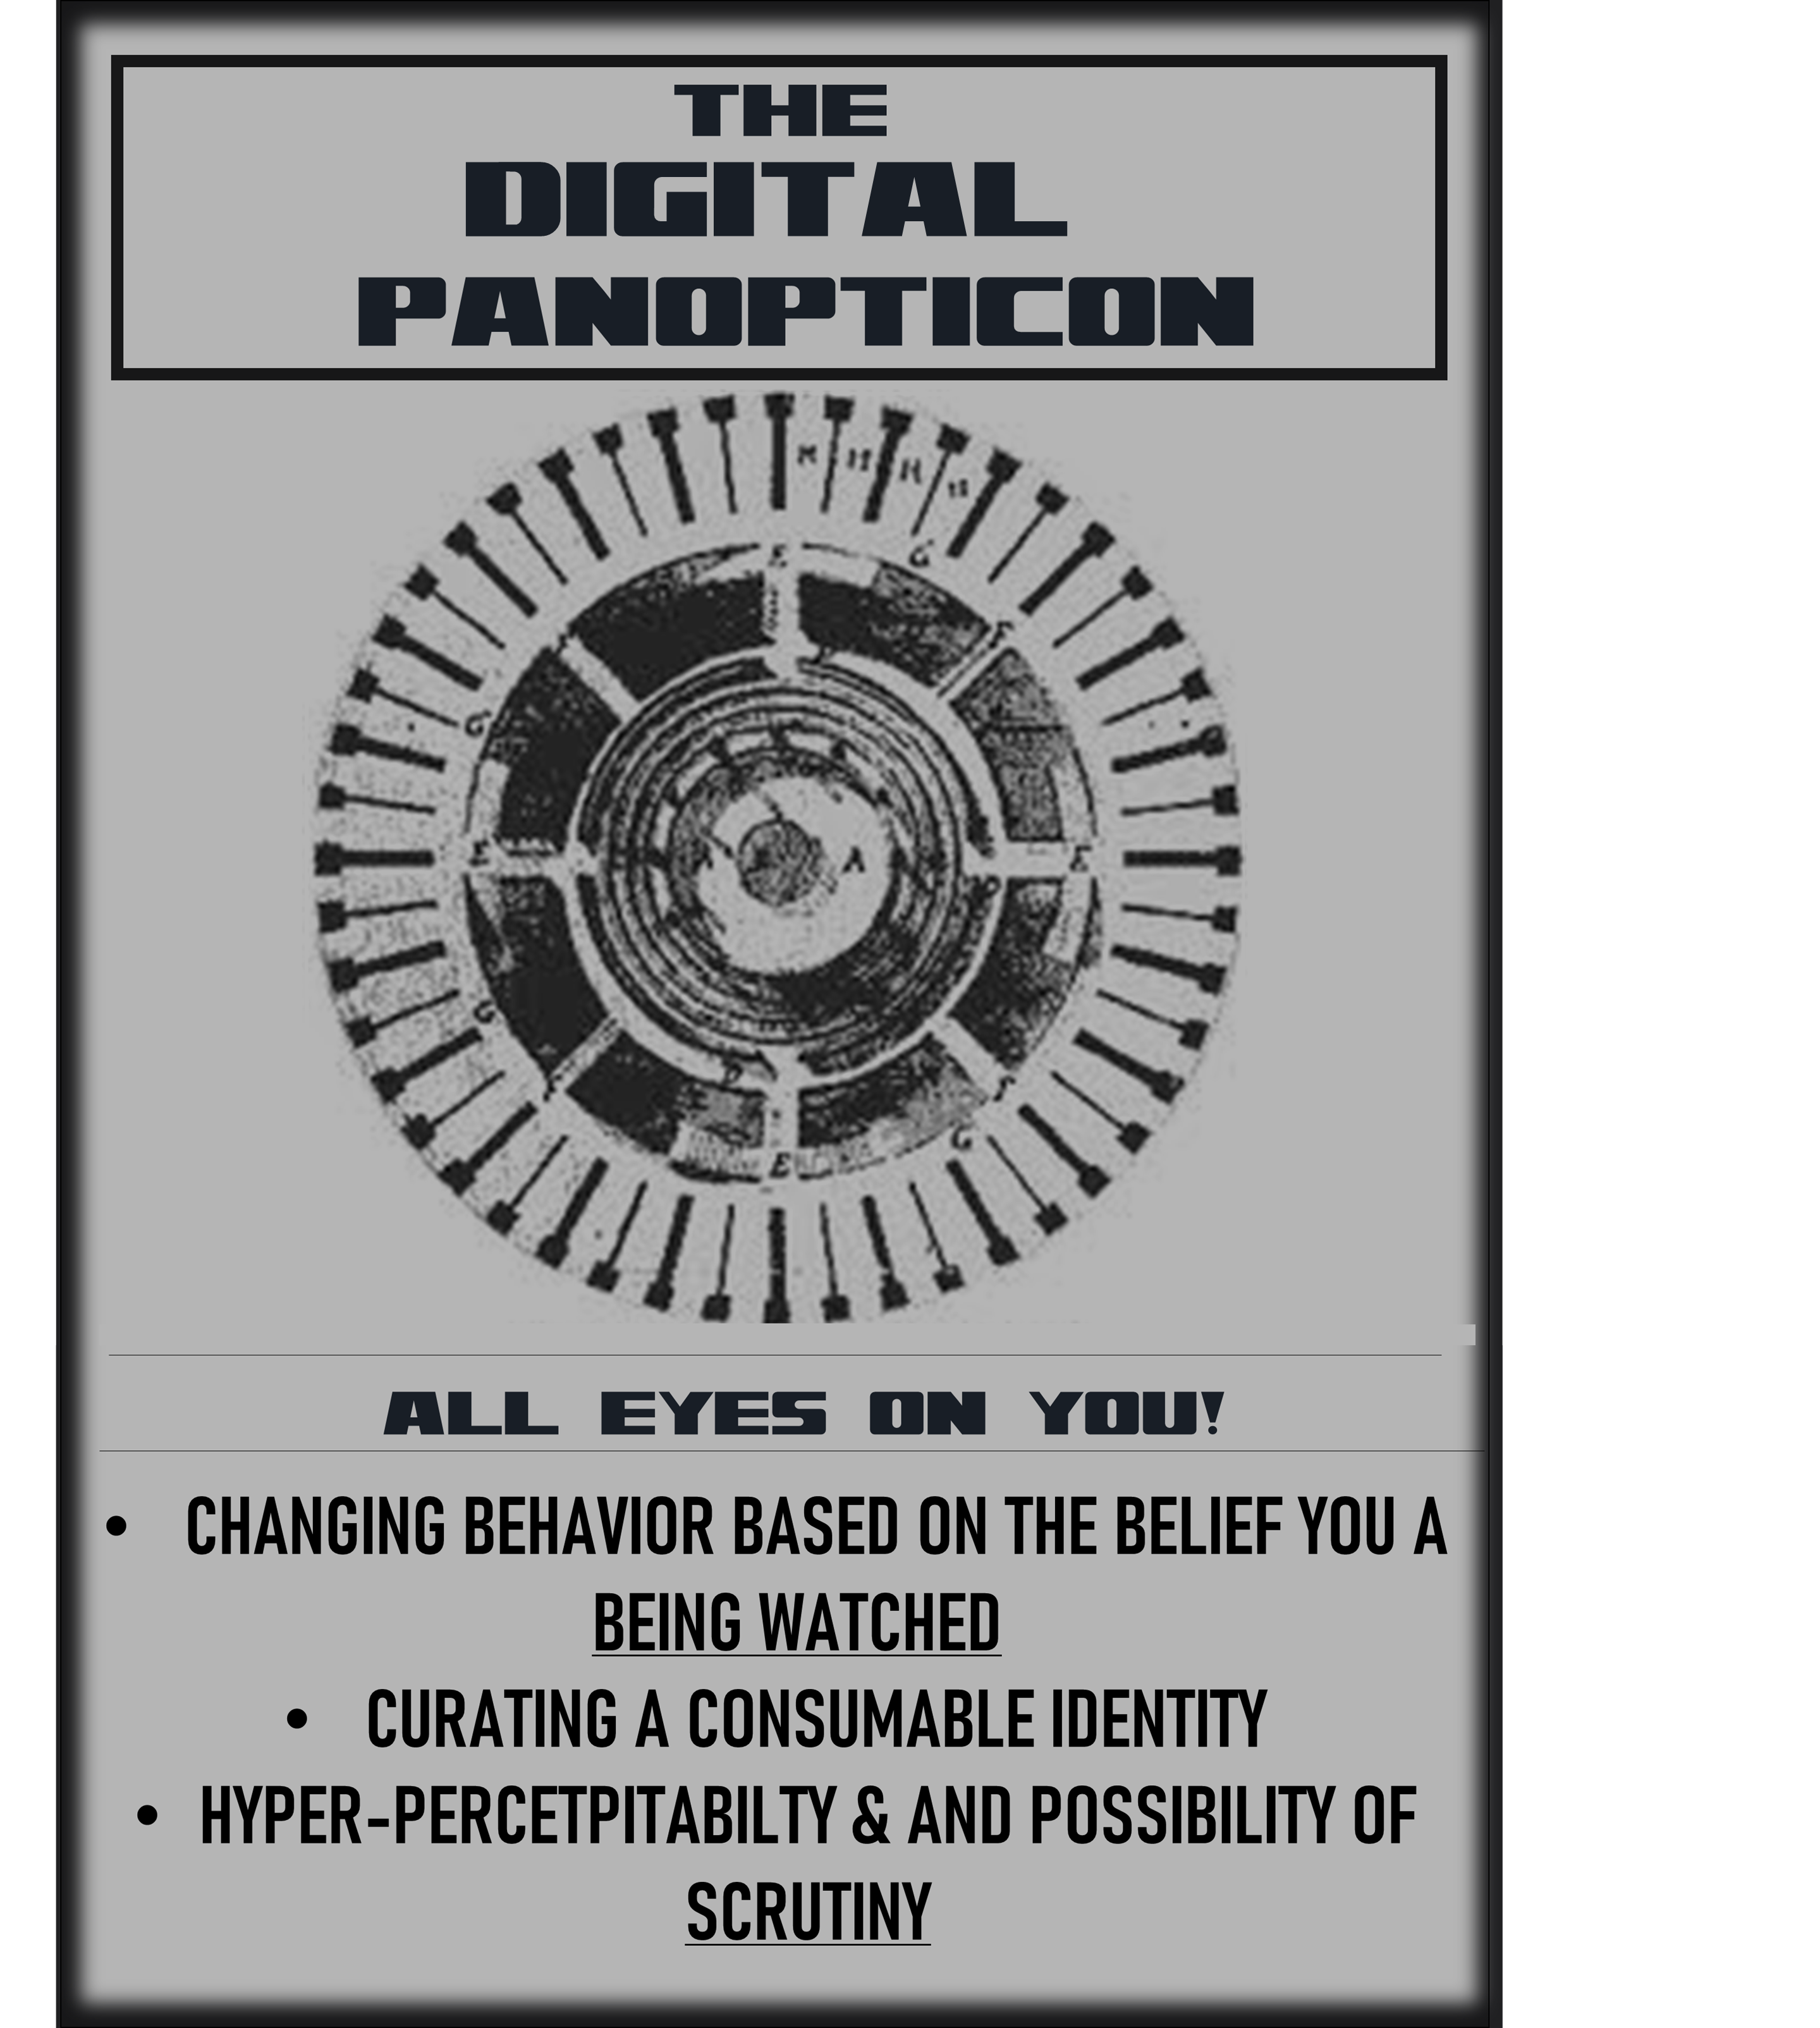
The
Genesis
A paradox
Heightened Surveillance
The
Conversation
Gen Z is constantly being oversaturated with possibilities in regard to their individualism enabling a sense of agency over who they are.
The
panopticon
However, due to their awareness of surveillance and what surveillance entails they contribute to the realization of conformity.
A PARADOX
BRAVE
NEW WORLD
Doctor
Who
Falling victim to Chomsky's manufactured consent...
BLACK
MIRROR
Barbie
hunger games
The
question

Slide 11
The
Genesis
Heightened Surveillance
The
Conversation
The
panopticon
A PARADOX
BRAVE
NEW WORLD
Doctor
Who
BLACK
MIRROR
Barbie
hunger games
The
question

Slide 12
The
Genesis
A paradox:
Manufactured Consent
Heightened Surveillance
The
Conversation
The
panopticon
Mass communication media is used as a way to manage public opinion through the manufacturing of fake/false choices to force ideologies.
A PARADOX
Intentional division via targeted ads that enable confirmation bias
More people interact - the more engagement - the more big tech knows about you- sell and use your information.
BRAVE
NEW WORLD
Doctor
Who
BLACK
MIRROR
Barbie
hunger games
The
question

Slide 13
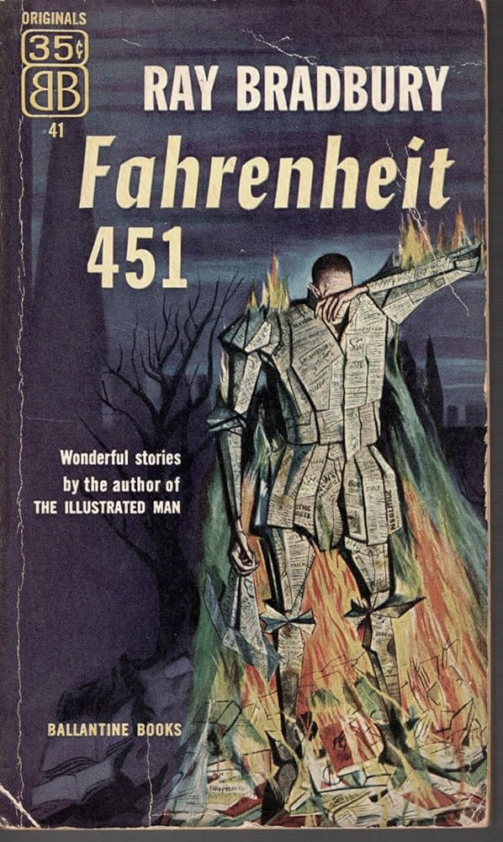
The
Genesis
A paradox:
Fahrenheit 451
Heightened Surveillance
The
Conversation
The government exercises control over society by suppressing and censoring literature.
The
panopticon
Controlling the flow of information and limiting intellectual freedom, the government effectively manufactures consent, shaping society according to its own agenda and suppressing dissenting voices.
A PARADOX
BRAVE
NEW WORLD
BLACK
MIRROR
Barbie
hunger games
The
question

Slide 14
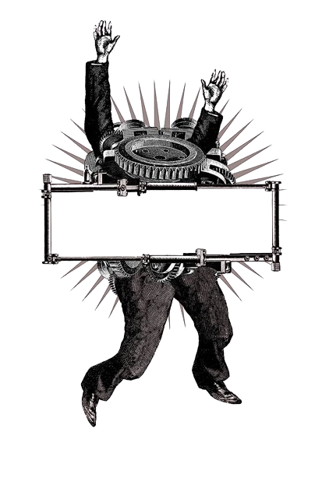
The
Genesis
Brave New world
ILLUSION OF CHOICE AND OVERSATURATION OF MEDIA
Heightened Surveillance
The
Conversation
The
panopticon
A PARADOX
BRAVE
NEW WORLD
BRAVE
NEW WORLD
Doctor
Who
BLACK
MIRROR
Barbie
hunger games
The
question

Slide 15
The
Genesis
Brave New world
ILLUSION OF CHOICE AND OVERSATURATION OF MEDIA
Heightened Surveillance
The
Conversation
Instead of the blatant surveillance like in 1984, the government in Brave New World controls the populous in a more insidious way.
A strict caste system controls every aspect of a person's life, from their likes and dislikes, which are chosen for them at birth.
The
panopticon
A PARADOX
BRAVE
NEW WORLD
BRAVE
NEW WORLD
Doctor
Who
BLACK
MIRROR
Barbie
hunger games
The
question

Slide 16
The
Genesis
Brave New world
ILLUSION OF CHOICE AND OVERSATURATION OF MEDIA
Heightened Surveillance
The
Conversation
The population is kept happy and distracted with various forms of entertainment and drugs to keep them from facing the harsh realities of their cold, empty world.
False belief that they are content and an individual.
The
panopticon
A PARADOX
BRAVE
NEW WORLD
BRAVE
NEW WORLD
Doctor
Who
BLACK
MIRROR
Barbie
hunger games
The
question

Slide 17
The
Genesis
Doctor who
Normalization of surveillance and
Reality television
Heightened Surveillance
The
Conversation
The
panopticon
A PARADOX
BRAVE
NEW WORLD
Doctor
Who
BLACK
MIRROR
Barbie
hunger games
The
question

Slide 18
The
Genesis
Doctor who
Normalization of surveillance and
Reality television
Heightened Surveillance
The
Conversation
The Long Game
The
panopticon
Though having explicit commentary on surveillance that directly aligns with the themes of illusion of choice and over saturation of media, I have observed an underlining plot point that underscores a more subtle, yet obvious way surveillance is normalized and depicted within the narrative and reflected in the world.
A PARADOX
BRAVE
NEW WORLD
Doctor
Who
BLACK
MIRROR
Barbie
hunger games
The
question

Slide 19
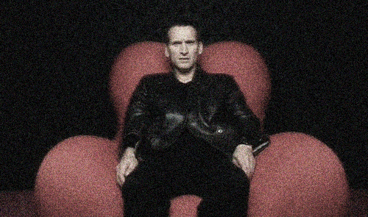
The
Genesis
Doctor who
Normalization of surveillance and
Reality television
Heightened Surveillance
The
Conversation
'Satellite 5
The
panopticon
The 9th Doctor and Rose have travelled forward in time to the year 200,000 and land aboard Satellite 5, a space station in Earth’s orbit during the Fourth Great and Bountiful Human Empire.
People are picked off Earth at random and are teleported to satellite 5 where they must participate in various reality TV show games in which they must try to be as entertaining as possible and liked by the viewers in order to stay in the game. If they lose they die.
Satellite 5 broadcasts six hundred channels of constant news reports and reality television throughout the empire
A PARADOX
BRAVE
NEW WORLD
Doctor
Who
BLACK
MIRROR
Barbie
hunger games
The
question

Slide 20
The
Genesis
Doctor who
Normalization of surveillance and
Reality television
Heightened Surveillance
The
Conversation
Reality TV
The
panopticon
Reality television became globally popular in the late 1990s and early 2000s, with the successes of the Big Brother franchise.
The popularization of a reality show game about surveillance that was inspired by a cautionary narrative warning us about surveillance began the normalization of surveillance on a more blatant scale.
A PARADOX
BRAVE
NEW WORLD
Doctor
Who
BLACK
MIRROR
Barbie
hunger games
The
question

Slide 21
The
Genesis
Heightened Surveillance
The
Conversation
The
panopticon
A PARADOX
BRAVE
NEW WORLD
BRAVE
NEW WORLD
Doctor
Who
BLACK
MIRROR
Barbie
hunger games
The
question

Slide 22
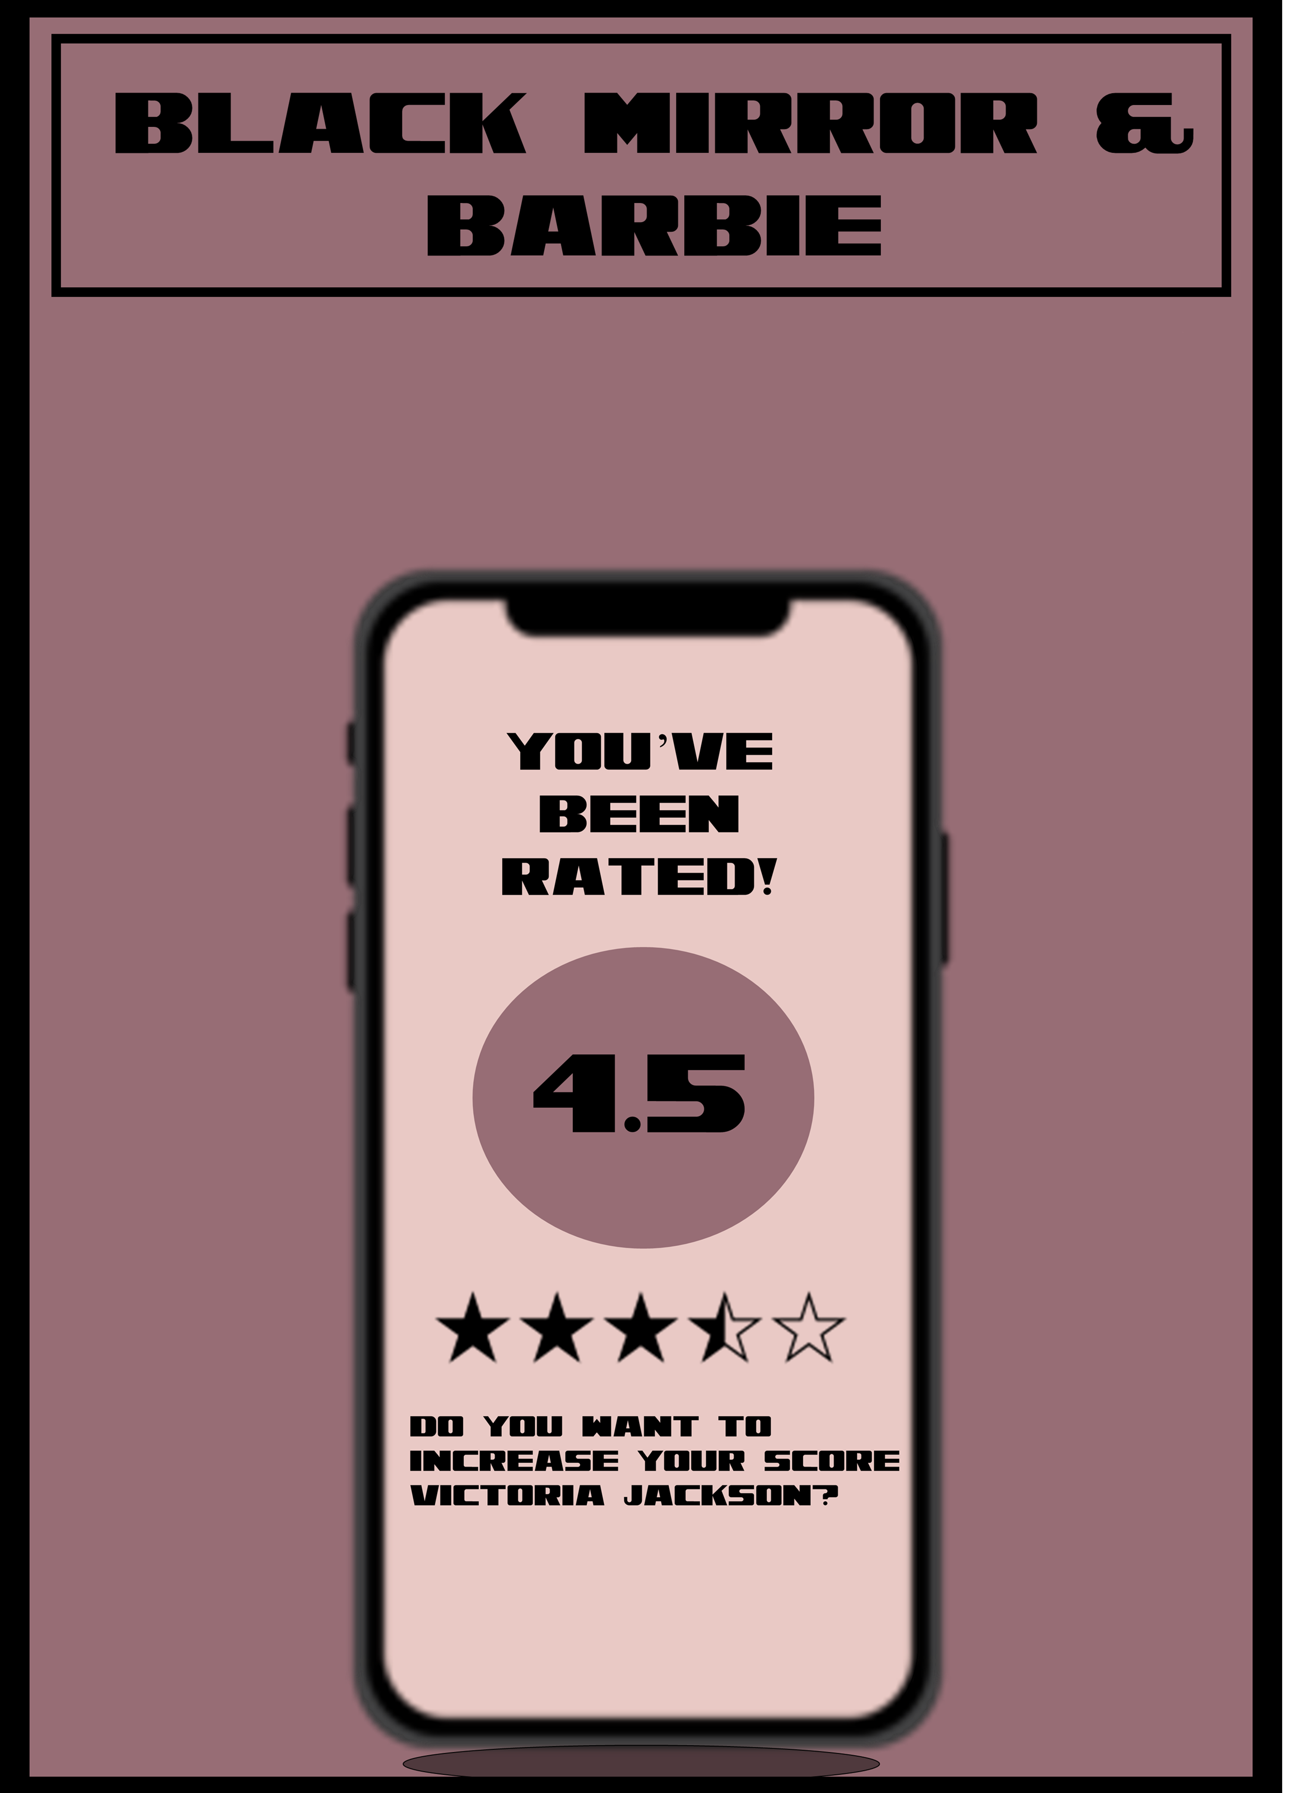
The
Genesis
Black Mirror’s nosedive
False Interconnectedness and
Conspicuous consumption
Heightened Surveillance
The
Conversation
The
panopticon
The main character navigates a world where people rate each other after every interaction and the rating determines opportunity and relationship
Everyone is a content creator
Creates false interconnectedness within communities because no one is authentically themselves
This may sound out there…but it is something that has been implemented by the Chinese government in 2020.
“Sesame Credit”
Has a real-life effect on relationships and opportunities among Chinese citizens
A PARADOX
BRAVE
NEW WORLD
BRAVE
NEW WORLD
Doctor
Who
BLACK
MIRROR
Barbie
hunger games
The
question

Slide 23
The
Genesis
Black Mirror’s nosedive
False Interconnectedness and
Conspicuous consumption
Heightened Surveillance
The
Conversation
The
panopticon
The characters within the episode show conspicuous consumption by taking a picture of what they own in hopes of getting a higher rating
The Barbie movie depicts conspicuous consumption in a way that is more focused on identity rather than perception
A PARADOX
BRAVE
NEW WORLD
BRAVE
NEW WORLD
Doctor
Who
BLACK
MIRROR
Barbie
hunger games
The
question

Slide 24
The
Genesis
Black Mirror’s nosedive
False Interconnectedness and
Conspicuous consumption
Heightened Surveillance
The
Conversation
Barbie’s identity as a “type of girl” is based on the things she buys that make her, her.
The Barbies in Barbie Land have a false idea of what makes an individual- they categorize themselves based on what they own
This is seen time and time again on social media.
The
panopticon
A PARADOX
BRAVE
NEW WORLD
BRAVE
NEW WORLD
Doctor
Who
BLACK
MIRROR
Barbie
hunger games
The
question

Slide 25
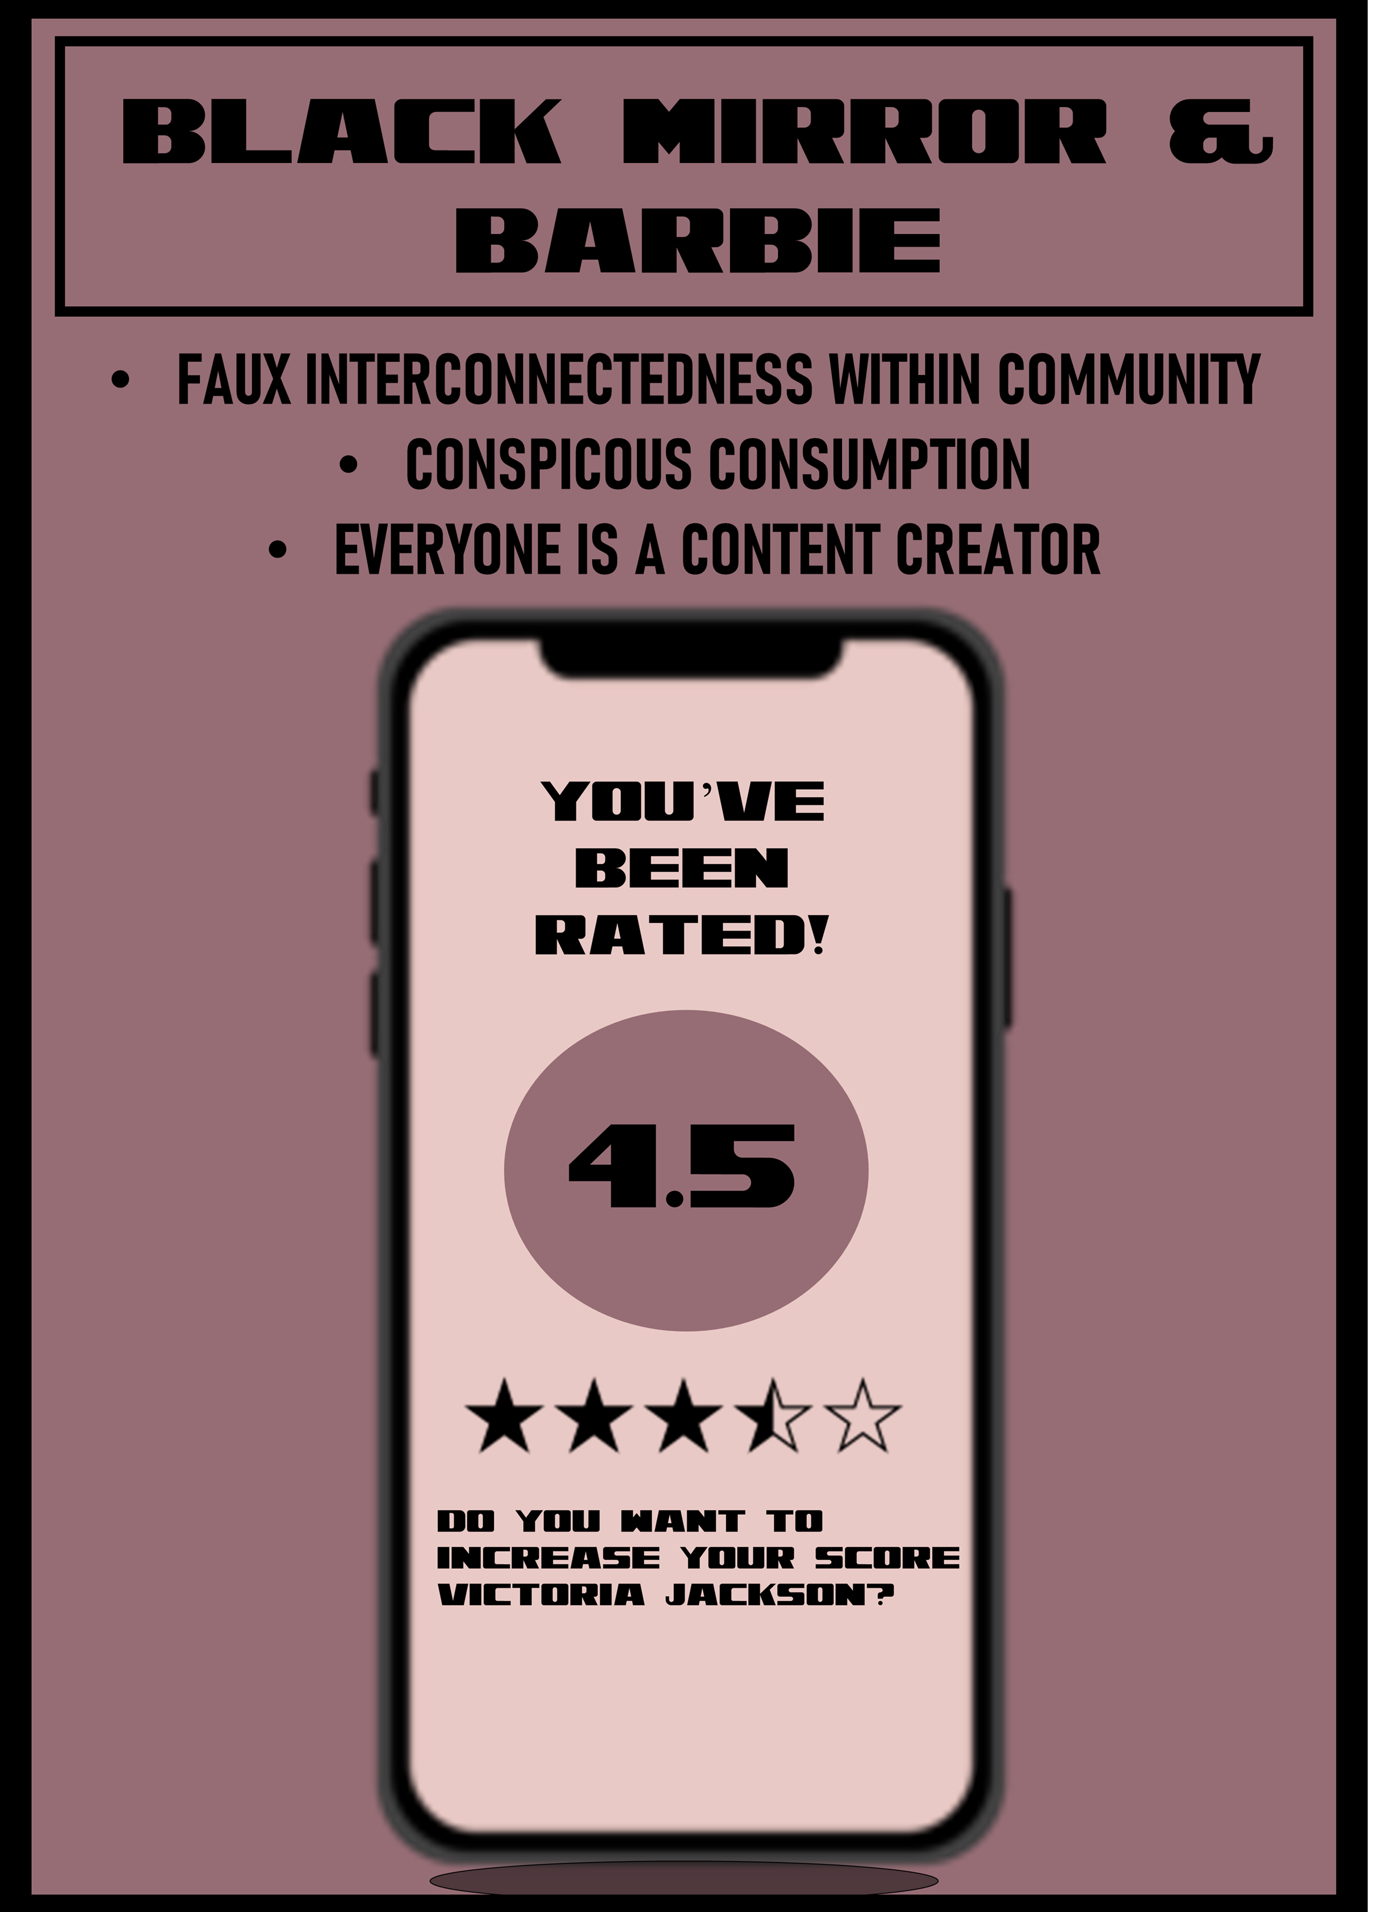
The
Genesis
Heightened Surveillance
The
Conversation
The
panopticon
A PARADOX
BRAVE
NEW WORLD
BRAVE
NEW WORLD
Doctor
Who
BLACK
MIRROR
Barbie
hunger games
The
question

Slide 26
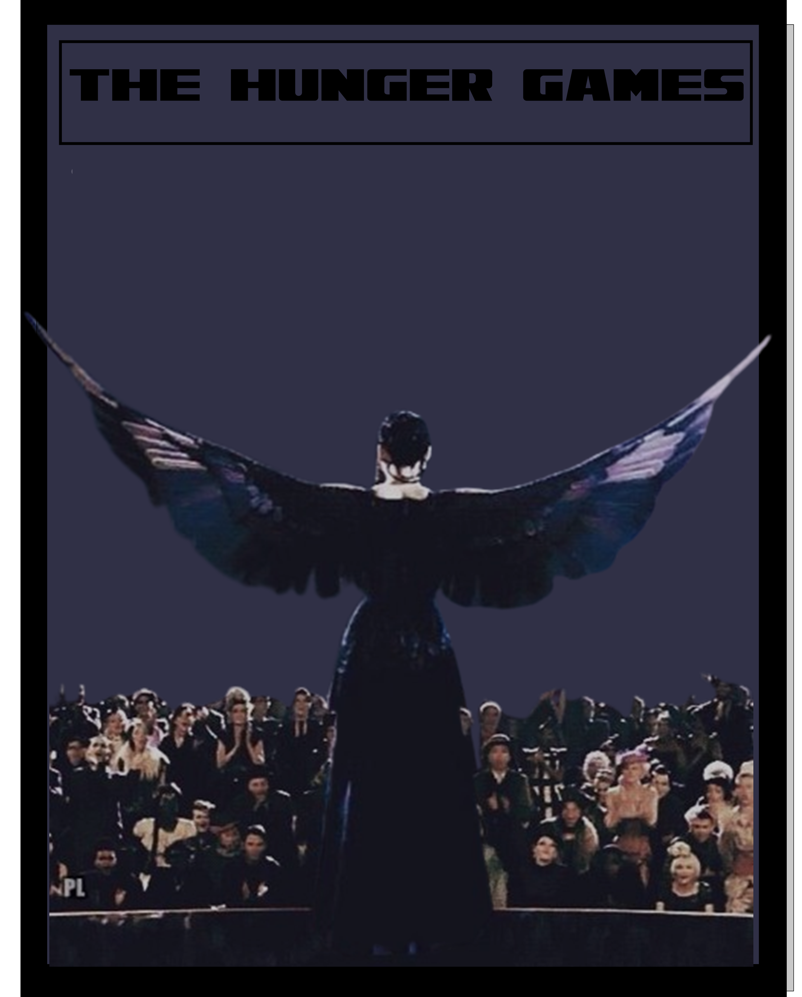
The
Genesis
THE HUNGER GAMES
Exploitation through surveillance to prove individual existence
Heightened Surveillance
The
Conversation
The
panopticon
A PARADOX
BRAVE
NEW WORLD
BRAVE
NEW WORLD
Doctor
Who
BLACK
MIRROR
Barbie
hunger games
The
question

Slide 27
The
Genesis
THE HUNGER GAMES
Exploitation through surveillance to prove individual existence
Heightened Surveillance
The
Conversation
The Capitol maintains its control over the 12 districts by forcing them each to select tributes, to compete in a nationally televised event called the Hunger Games. Every citizen must watch as the youths fight to the death until only one remains.
Done to keep order within the districts and as entertainment for people in the capital
The
panopticon
A PARADOX
BRAVE
NEW WORLD
BRAVE
NEW WORLD
Doctor
Who
BLACK
MIRROR
Barbie
hunger games
The
question

Slide 28
The
Genesis
THE HUNGER GAMES
Exploitation through surveillance to prove individual existence
Heightened Surveillance
The
Conversation
Tributes must become a “brand” so that people of the capitol send them donations, so they have an advantage in the game
Citizens of the capitol view the Hunger Games as a reality show
Exploitation of an individual to prove why their existence should continue.
The
panopticon
A PARADOX
BRAVE
NEW WORLD
BRAVE
NEW WORLD
Doctor
Who
BLACK
MIRROR
Barbie
hunger games
The
question

Slide 29
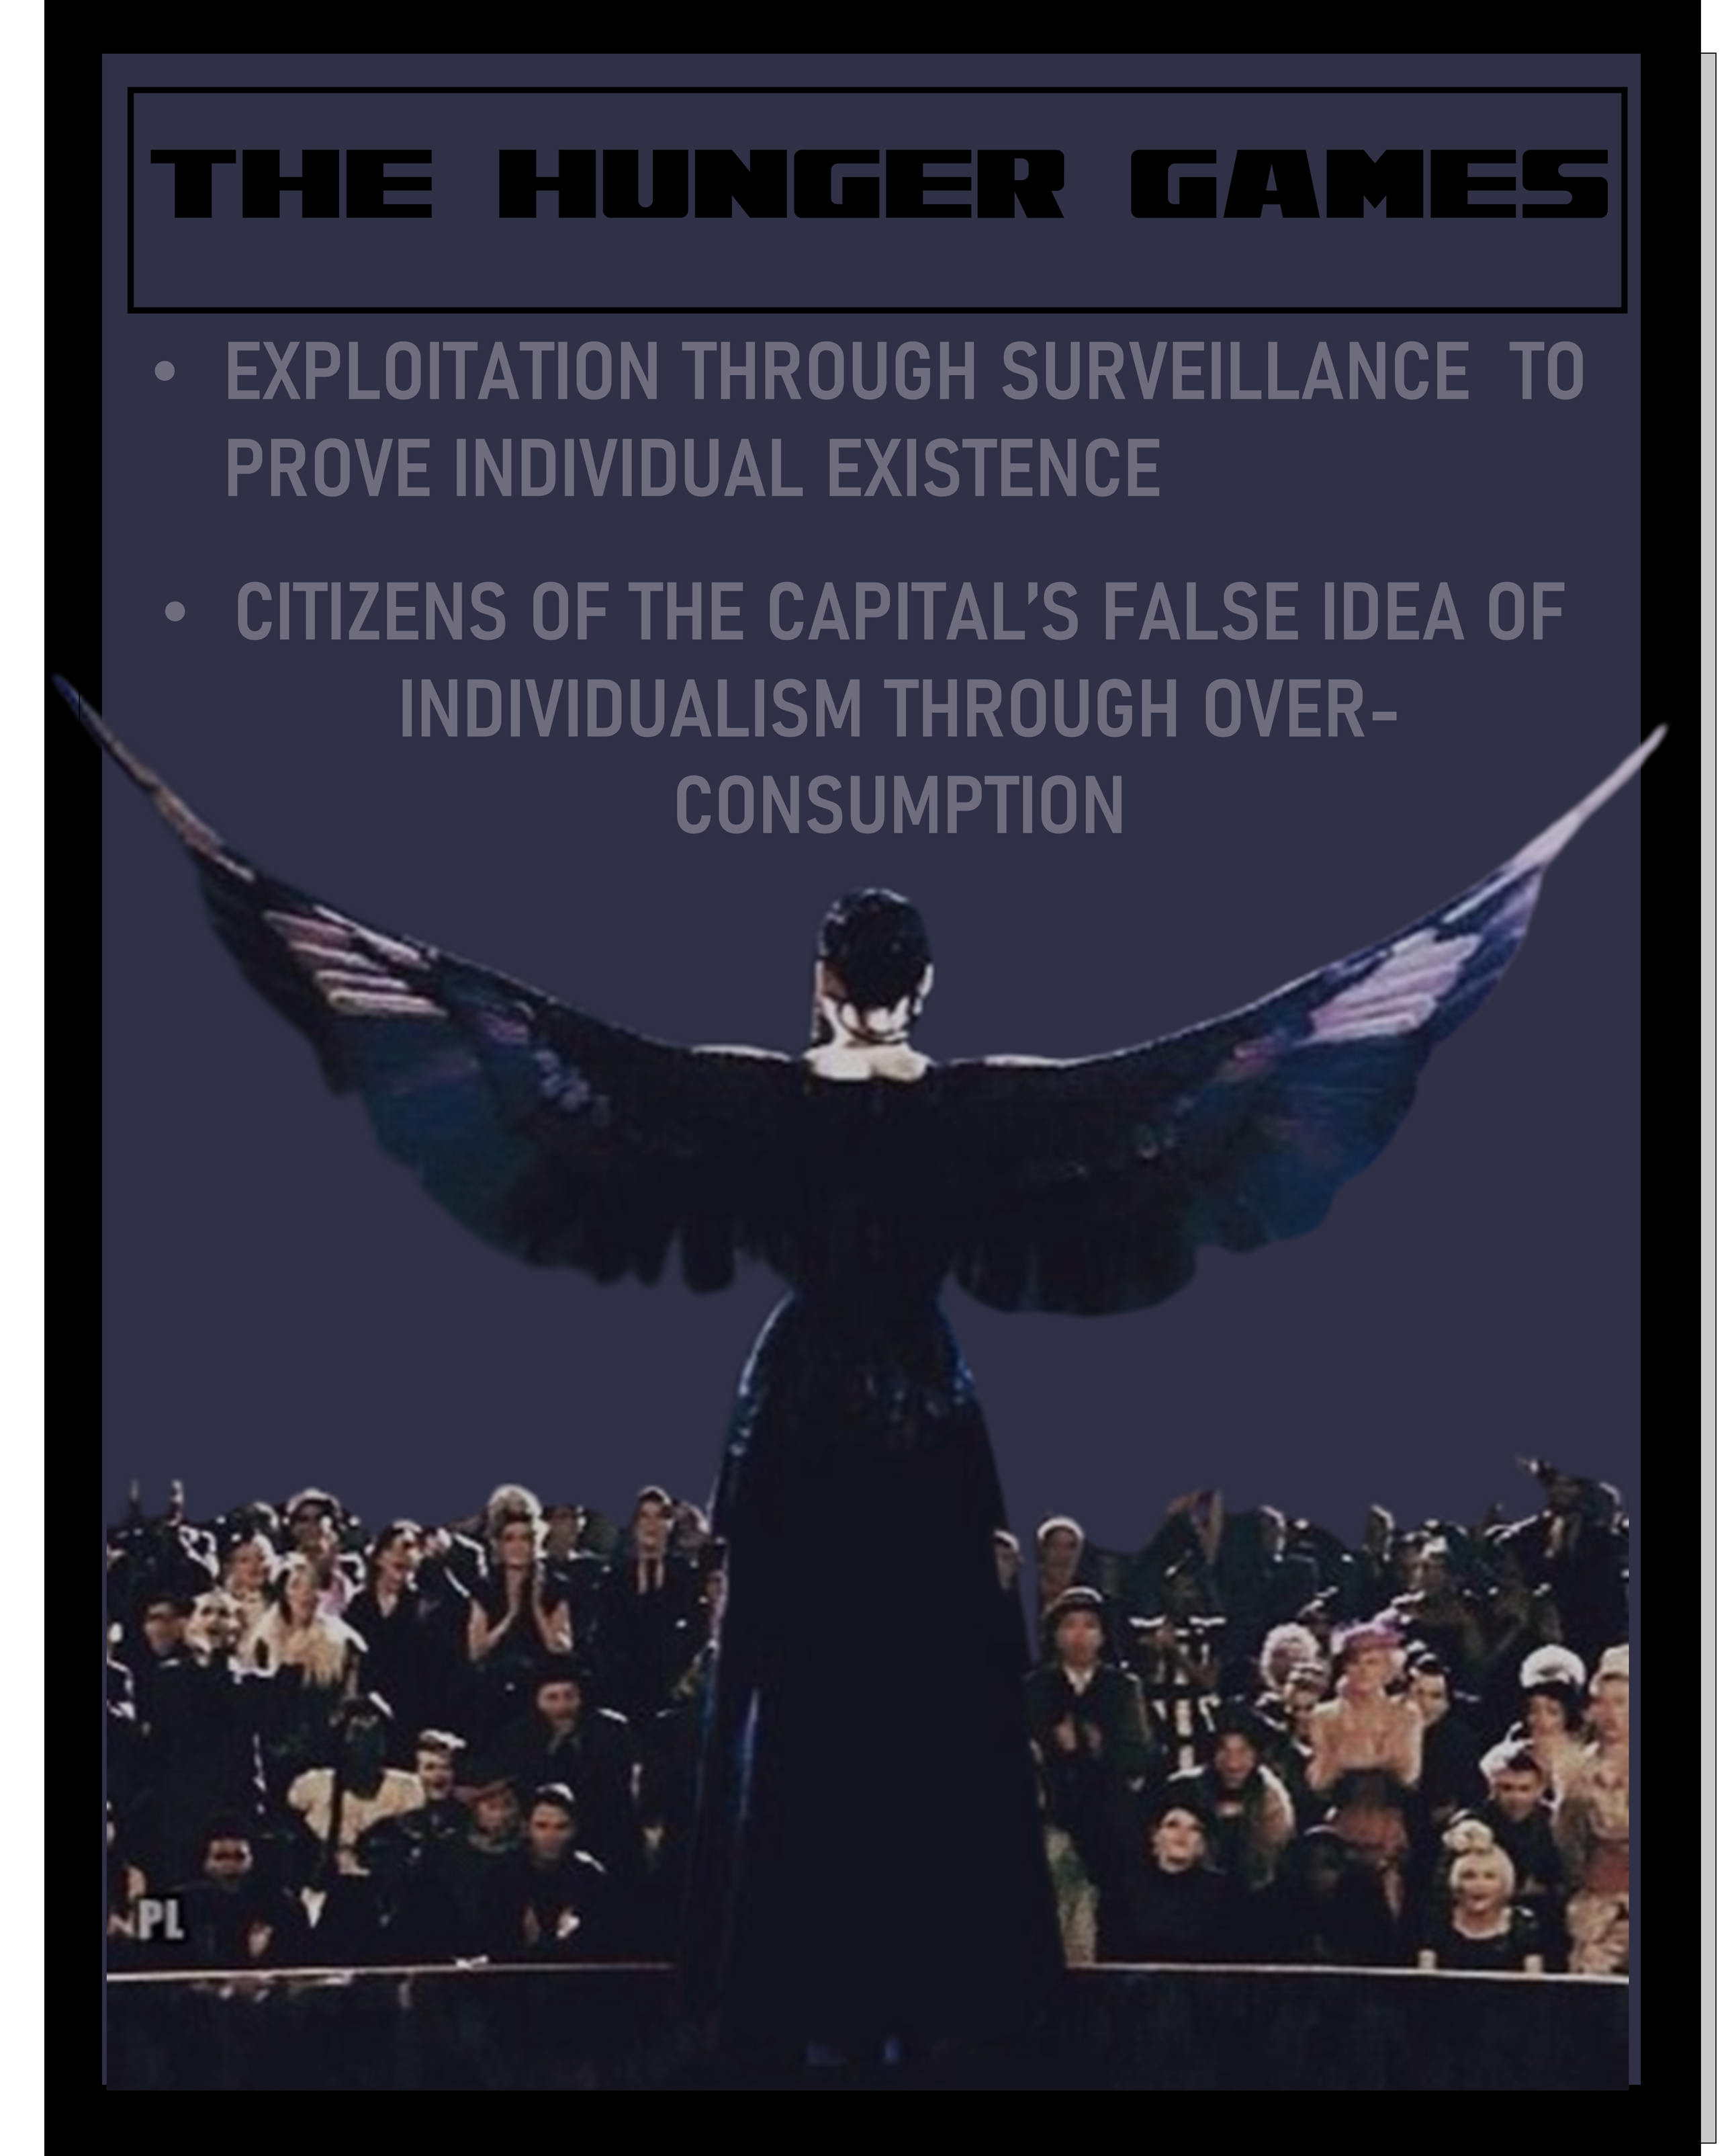
The
Genesis
THE HUNGER GAMES
Exploitation through surveillance to prove individual existence
Heightened Surveillance
The
Conversation
How to be Katniss Everdeen?
You can’t be. You’re an American.
2. As an American, you are a citizen of the Capitol.
3. Citizens of the Capitol are victims of an over-consumerist society that has a false illusion of individuality manufactured by the government.
4. Katniss Everdeen is not the Mockingjay because she wants to be perceived as a hero, she is the Mockingjay because she was forced to become a hero.
The
panopticon
A PARADOX
BRAVE
NEW WORLD
BRAVE
NEW WORLD
Doctor
Who
BLACK
MIRROR
Barbie
hunger games
hunger games
The
question

Slide 30
The
Genesis
THE HUNGER GAMES
Exploitation through surveillance to prove individual existence
Heightened Surveillance
The
Conversation
Influence
The Hunger Games is one of the most influential dystopian narratives among Generation Z.
Generation Z views the Hunger Games franchise as commentary and is aware of the implications of the heightened surveillance within the film
However, still with this knowledge they continue to unwittingly contribute to the evitable realization of the feature feared within the dystopian narratives they consume.
The
panopticon
A PARADOX
BRAVE
NEW WORLD
BRAVE
NEW WORLD
Doctor
Who
BLACK
MIRROR
Barbie
hunger games
hunger games
The
question

Slide 31
The
Genesis
Is escaping this surveillance culture possible or even desirable?
How will this problem continue to transpire?
Heightened Surveillance
The
Conversation
The
panopticon
A PARADOX
Questions
BRAVE
NEW WORLD
BRAVE
NEW WORLD
Doctor
Who
BLACK
MIRROR
One I can answer is: Why does it matter?
How many more warnings do we need?
Barbie
hunger games
The
question

