Slide 1


Slide 2
"I’m Sorry, Laura, I Don’t Understand the Question"
The Trace of Counter-Intuitive Pessimism in UBI/AI Stories: Humans, Westworld, The Expanse, and Star Trek
Warren Jones Matt Hudson

Slide 3
Introduction
Generations
Baby Boomers vs. Millennials
AI/UBI
Sci-Fi Dystopias & Utopias
Futurism
Adorno and the Culture Industry
20th c. Culture Industry
21st c. Culture Industry
Mirrored Experience
Need for Humanities
"I’m Sorry, Laura, I Don’t Understand the Question"
The Trace of Counter-Intuitive Pessimism in UBI/AI Stories: Humans, Westworld, The Expanse, and Star Trek
Warren Jones Matt Hudson

Slide 4
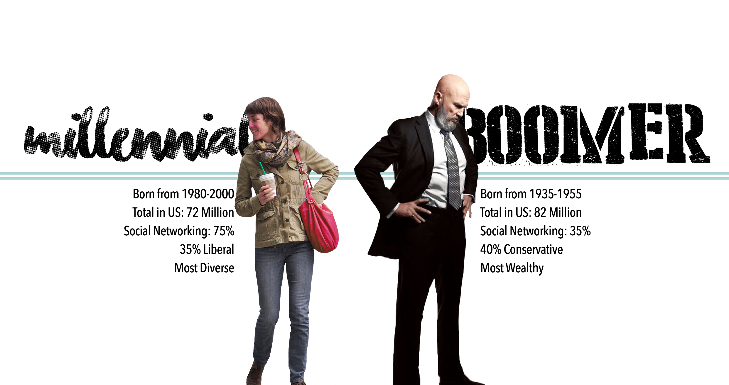
Introduction
Generations
Baby Boomers vs. Millennials
AI/UBI
Sci-Fi Dystopias & Utopias
Futurism
Adorno and the Culture Industry
20th c. Culture Industry
21st c. Culture Industry
Mirrored Experience
Need for Humanities
Boomers VERSUS Millennials
The public media war

Slide 5
Beer
(Business Insider, 2017)
2. J. Crew
(Nylon.com, 2017)
3. Department stores
(USA Today, 2017)
4. Motorcycles
(CNBC, 2017)
5. Diamonds
(TheDailyBeast.com, 2016)
6. Golf
(Business Insider, 2016)
7. Bar soap
(Moneyish.com, 2017)
8. College football
(TheBigLead.com, 2017)
9. Lunch
(Fortune, 2017)
10. McDonalds
(Gothamist.com, 2014)
11. Vacations
(Inc.com, 2016)
12. Napkins
(Business Insider, 2016)
13. Cars
(DrivingSales.com, 2013)
14. Crowdfunding
(Bossip.com, 2016)
15. Wine
(Quench.me, 2016)
16. Wine corks (almost!)
(The Atlantic, 2016)
70 Things Millennials are Killing
A Mashable.com linked list of articles
55. Applebee's
(TrendingAllDay, 20017)
56. Fashion
(VibetheVibe.com, 2015)
57. Hangout sitcoms
(Refinery29.com, 2015)
58. The Big Mac
(RedAlertPolitics.com, 2016)
59. Stilettos
(Elle.com, 2016)
60. Romance
(FizzyMag.com, 2017)
61. The 9-to-5 workday
(Entrepreneur.com, 2016)
62. The NFL
(CSMonitor.com, 2012)
63. Gen X's retirement
(Time.com, 2015)
64. The Olympics
(Gizmodo.com, 2016)
65. Brunch
(NYPost.com, 2017)
66. The European Union
(NationaInterest.com, 2016)
67. Baby names
(Time.com, 2016)
68. Banks
(TechCrunch.com, 2015)
69. Oil
(Oilprice.com, 2016)
70. Everything
(Manoanow.org, 2017)
17. The Toyota Scion
(Forbes, 2016)
18. Fabric softener
(WSJ, 2016)
19. Marriage
(Bloomberg.com, 2017)
20. The McWrap
(Eater.com, 2016)
21. Handshakes
(Metro.co.uk, 2016)
22. Canadian Tourism
(NotableLife.com, 2016)
23. Light yogurt
(Business Insider, 2016)
24. Gambling
(Knockoutmag.com, nd)
25. Hotels
(Mashable.com, 2016)
26. Relationships
(SheKnows.com, 2015)
27. Marmalade
(Metro.co.uk, 2017)
28. Running
(Wall Street Journal, 2016)
29. Cereal
(GQ, 2016)
30. The anti-aging industry
(TheCut.com, 2017)
31. Buffalo Wild Wings
(Business Insider, 2017)
32. Focus groups
(CrimsonHexagon.com, nd)
33. Travel marketing
(MDGAdvertising.com, nd)
34. Working
(Phillymag.com, 2016)
35. Credit
(eMerchantbroker.com, 2017)
36. Trees
(2machines.com, nd)
37. The American Dream
(RedAlertPolilitics.com, 2015)
38. America
(Medium.com, 2016)
39. Democracy in general
(Medium.com, 2016)
40. Home Depot
(Forbes, 2014)
41. Self-pity
(Cityam.com, 2016)
42. 2016 Elections
(Washington Post, 2016)
43. Consumerism
(Extranewsfeed.com, 2017)
44. Suits
(New Boston Post, 2016)
45. Dinner dates
(NYPost.com, 2016)
46. Movies
(NYPost.com, 2016)
47. Sex
(IBTimes.co.uk, 2017)
48. Gyms
(NYPost.com, 2016)
49. Serendipity
(Guestofaguest.com, 2017)
50. Loyalty programs
(SocialTables.com, nd)
51. Loyalty in general
(Boston.com, 2016)
52. Taking risks
(LATimes.com, 2016)
53. Patriotism
(Stream.org, 2017)
54. Cruises
(CaribbeanNewsService, 2016)
Financial News
Status Items

Slide 6
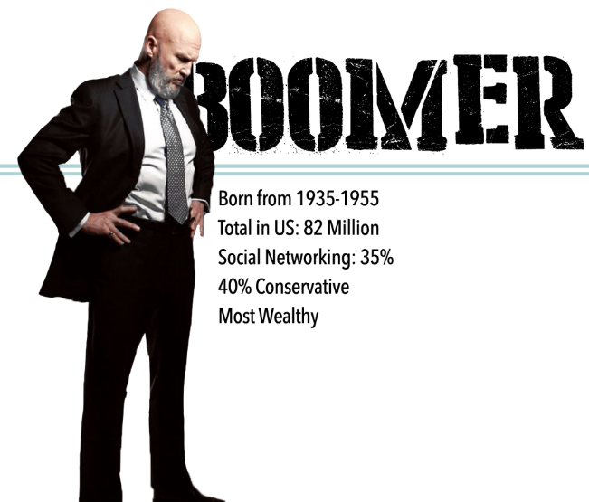
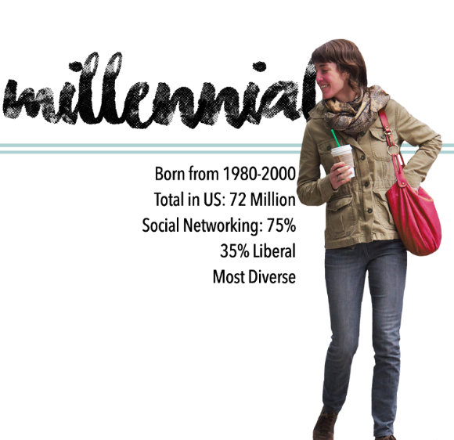
Introduction
Generations
Baby Boomers vs. Millennials
AI/UBI
Sci-Fi Dystopias & Utopias
Futurism
Adorno and the Culture Industry
20th c. Culture Industry
21st c. Culture Industry
Mirrored Experience
Need for Humanities
Boomers VERSUS Millennials Ideologies
Conspicuous Consumption
Thrift/Usage/Purpose
Tempered Uniqueness
Authenticity
Versus
Mechanical Reproduction
Craft/Homemade
Hard Work/Dedication
Skills/Achievement

Slide 7
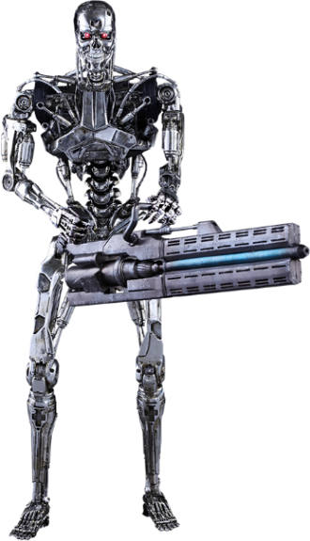
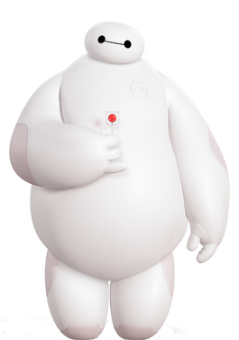


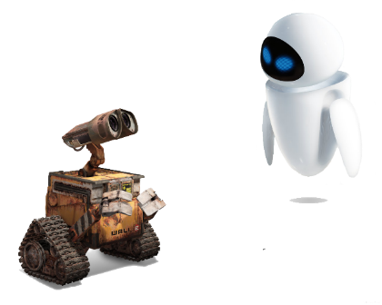
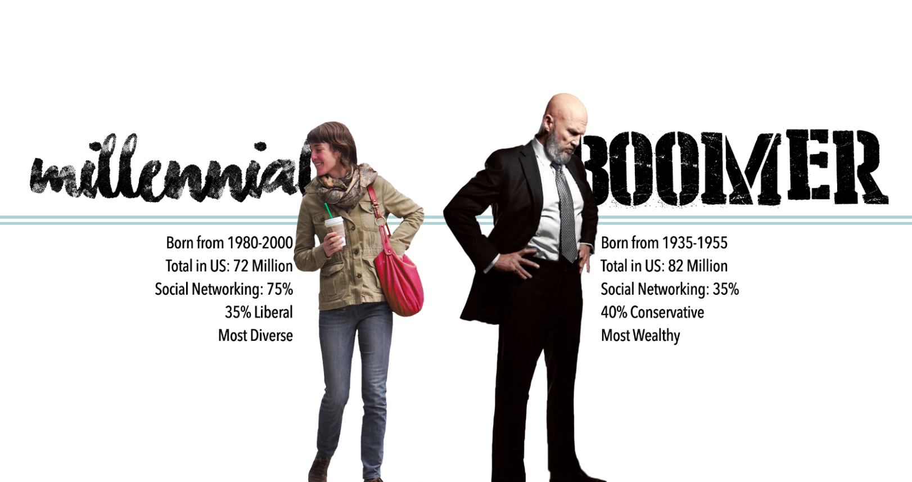
Introduction
Generations
Baby Boomers vs. Millennials
AI/UBI
Sci-Fi Dystopias & Utopias
Futurism
Adorno and the Culture Industry
20th c. Culture Industry
21st c. Culture Industry
Mirrored Experience
Need for Humanities
Boomers VERSUS Millennials UBI/AI

Slide 8
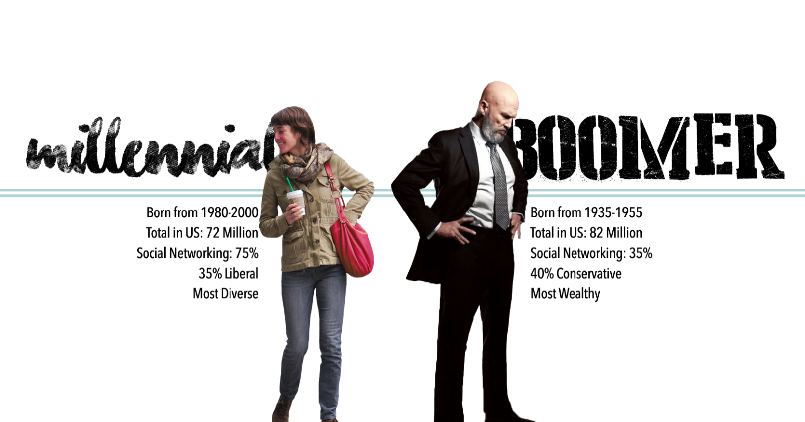
Introduction
Generations
Baby Boomers vs. Millennials
AI/UBI
Sci-Fi Dystopias & Utopias
Futurism
Adorno and the Culture Industry
20th c. Culture Industry
21st c. Culture Industry
Mirrored Experience
Need for Humanities
Boomers VERSUS Millennials UBI/AI
Conspicuous Consumption
Thrift/Usage/Purpose
Tempered Uniqueness
Authenticity
Versus
Mechanical Reproduction
Craft/Homemade
Hard Work/Dedication
Skills/Achievement

Slide 9
Boomers VS Millennials
Dystopias
Introduction
Generations
Baby Boomers vs. Millennials
AI/UBI
Sci-Fi Dystopias & Utopias
Futurism
Adorno and the Culture Industry
20th c. Culture Industry
21st c. Culture Industry
Mirrored Experience
Need for Humanities
Baby Boomer Dystopias
to warn of us against
Overpowering Dystopias
Millennial Dystopias
Disconnect of people from people
especially through technology
MegaCity One from Dredd
Eurasia from 1984
Australia from Mad Max
Zion from The Matrix
Britain from A Clockwork Orange
The whole world in The Walking Dead
East Coast America in Black Summer
Reality and the Shimmer in Annihilation
Citizen Z from Z Nation
Pandora from Avatar

Slide 10

Boomers VS Millennials
Utopias
Introduction
Generations
Baby Boomers vs. Millennials
AI/UBI
Sci-Fi Dystopias & Utopias
Futurism
Adorno and the Culture Industry
20th c. Culture Industry
21st c. Culture Industry
Mirrored Experience
Need for Humanities
Baby Boomer Utopias
to show a better life through technological changes
Millennial Utopias
Show the connection of people
especially through technology
Orbit City in The Jetsons
Six Million Dollar Man
Bionic Woman
Star Trek (OST & TNG)
Back to the Future
Star Trek: Voyager
Big Hero 6
Cloudy w/ a Chance of Meatballs
Pandora in Avatar
Tomorrowland in Tomorrowland

Slide 11
Introduction
Generations
Baby Boomers vs. Millennials
AI/UBI
Sci-Fi Dystopias & Utopias
Futurism
Adorno and the Culture Industry
20th c. Culture Industry
21st c. Culture Industry
Mirrored Experience
Need for Humanities
End of Example

